Slide 1
Enhancing care for patients with joint pain
A workshop for physiotherapists
Notes:
Please see the separate MSWord file for an outline programme and timings for this workshop, intended as about a 3 hour session.
A separate slide set has some introductory information on the MOSAICS and JIGSAW projects, which underpin this workshop

Slide 2
Introductions
Notes:
An opportunity for participants to say something about themselves, their roles and experience. This is an informal workshop and sharing ideas and discussion of the material is key to its success. Setting the right atmosphere is important

Slide 3
Impact and diagnosis
Notes:
The workshop is divided into sections. The discussion on impact is about 15 minutes, then 30 minutes on concepts and diagnosis

Slide 4
Joint pain and how it affects a life
(Pairs discussion 10 minutes)
Think of someone you know with joint pain – patient, friend, relative
Describe that person to your neighbour and hear his/her account of a person too:
  Their life and aspirations
  What you think joint pain means to them?
  What impact does it have on their life?
  What do you feel about it?
Notes:
This is to emphasise the key element of holistic care:
It’s a person and not just a patient – most of life happens outside a consulting room
We all have expectations and aspirations, sometimes frustrated by physical limitations
People’s circumstances can affect the impact of a condition – work, housing, being a carer, etc
Understanding impact and health beliefs is key to providing appropriate care and support

Slide 5
Share general ideas on impact
Flip chart
2 key points from each pair
Notes:
The person-centred, holistic approach is important and the idea of this part is to see if there are any general points to be taken from the narratives

Slide 6
What is Osteoarthritis?
(Trios or small groups 10 mins)
What is your understanding of osteoarthritis?
Who does it affect?
What are the causes?
What structures are involved?
Notes:
Our professional education and experience may leave considerable gaps in our real understanding of conditions – we can develop pragmatic approaches and not think too deeply about underlying concepts. Having to articulate these ideas can reveal knowledge gaps; sharing concepts amongst colleagues can be helpful

Slide 7
Share ideas with wider group
Flip chart?
Capture few words/concepts?
Notes:
This is an optional activity. The small groups may have nailed all the issues, particularly if each group had a facilitator

Slide 8
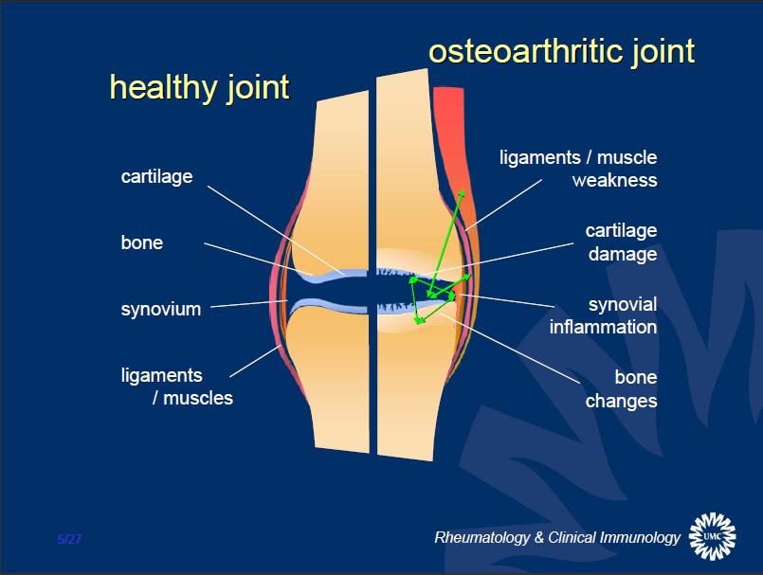
Notes:
This is a quick reminder to think about the whole joint, including ligaments and muscles and not just cartilage and synovium:
All joint tissues affected – cartilage / bone / synovium / ligaments and muscles
Pathology in all tissues – go through examples illustrated
Predominately driven by excess loading of the joint, for example through weight or injury
Joint is metabolically active – repair/re-modelling processes in response to stresses

Slide 9
Notes:
Trauma can be a contributory factor in the development of OA but not as often as many people believe. Certain sports, such as football and skiing, can cause injuries particularly to the knees that may predispose to osteoarthritis. Some occupations, particularly heavy work such as agriculture may also contribute. Trauma to joints through infection and accidents such as Road Traffic Accidents will increase the risk of developing OA but it can occur in those who have never done any more than move from their sofa to their office desk.

Slide 10
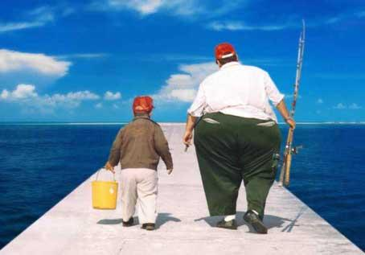
Notes:
OBESITY IS a major risk factor for developing Osteoarthritis and we know that reducing weight helps the pain from affected joints. New research has shown that it isn’t just the weight that is doing the damage, which is how we used to think of OA, but a much more complex picture of fatty tissue producing inflammatory chemicals, so-called cytokines, that can damage the joints and cause pain. This is why obese people are more likely to suffer osteoarthritis in their hand joints as well as in the weight bearing joints such as the knee and hip.

Slide 11
Understanding of OA has changed over time
Biomedical
Biopsychosocial
Simplistic mechanical “cartilage degeneration” and/or “bone-on-bone” descriptions
Symptom-based, chronic pain model
Symptoms are:
Variable
Often not progressive
Psychological and social components are important
Notes:
Unfortunately, a purely biomedical model still prevails amongst many health professionals: some GPs, radiographers, radiologists, surgeons. It is also the commonest paradigm amongst the general public and in the media. Resulting from this can be undue reliance on imaging, a view that little can be done to help and a readiness to resort to surgical intervention.
Physiotherapists are more familiar with a biopsychosocial approach and it is helpful to discuss this in the context of understanding others’ less helpful approaches.
With patients, it is much more effective to get the right message across from the start than to try to undo myths and unhelpful advice

Slide 12
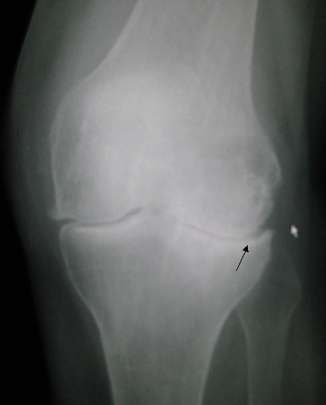
How to define OA:
Symptoms or X-rays?
Pain and function matter to patients
X-ray imaging does not add much:
  Many older people have x-ray changes of OA even without any symptoms
  Amount of pain not fully explained by degree of x-ray changes
MRI is unhelpful except in trauma
Notes:
Imaging is a controversial subject – many patients expect X-rays and many clinicians lack the confidence to diagnose OA without imaging. However, patients can have troublesome joint pain/OA without X-ray abnormalities, whilst many can have X-ray changes with minimal or no symptoms. Imaging can certainly be justified before planning surgery but clinicians and patients can get trapped into a pattern of repeated X-rays to “check progression”. Reporting of X-rays is very subjective and commonly used reporting terms like “degenerative joint disease” are unhelpful and demotivating.
For any clinical test, the crucial question is “How will the result change my management?”
Imaging can be the first step on a narrow path to surgery, which may not be best for the patient

Slide 13
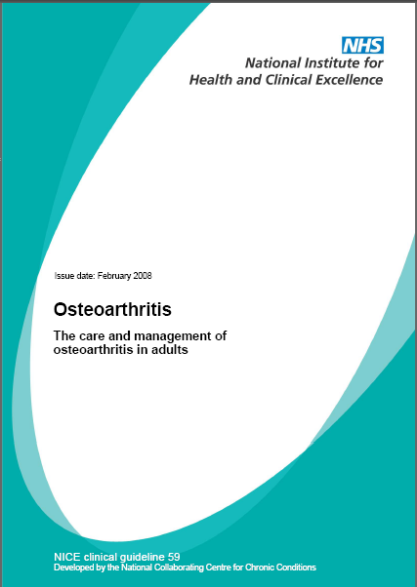
NICE: A working diagnosis of OA
  Persistent joint pain with use (knee, hip, hand)
  Age 45 years +
  Morning stiffness absent or less than ½ hour
  An alternative diagnosis is unlikely
Notes:
In line with the concept of a biopsychosocial approach, NICE characterises OA as a clinical syndrome, not a biomedical entity

Slide 14
Making the diagnosis
Understanding the problem
  The patient’s story
  Pain / mobility / activities (work & social)
  Ideas, concerns and expectations (ICE)
  What they have tried already
Clinical working diagnosis
  Typical OA history (examination?)
  Alternative diagnosis unlikely
Notes:
Gaining a clear understanding of the patient’s background, limitations, expectations, concerns and health beliefs is key to giving personalised advice and to shared decision-making.
Exploring what they have tried already may reveal unhelpful beliefs or behaviour e.g. reluctance to take prescribed medication or use of unproven and expensive products which they can ill-afford but have been advised to continue

Slide 15
Indicators of “alternative or additional diagnoses”
Fracture
History of trauma
Rapid worsening of symptoms
Gout
Other inflammatory arthritides (e.g. RA, PMR)
Prolonged morning joint-related stiffness
Hot swollen joint
Septic arthritis
Numbness
Malignancy
Systemic upset
Radicular or neuropathic pain
Notes:
This slide is just to provide a quick reminder of “red flags” and is not exhaustive

Slide 16
Natural history and population impact
Notes:
This session should occupy about 15 minutes

Slide 17
What can patients expect from OA?
(Pairs, trios or group 5 mins)
What is its natural history?
How might it develop in the next few months?
What is the eventual outcome?
Can anything change this?
Notes:
Patients’ health beliefs, experiences of family and friends, media and comments of professionals can all influence their view of the condition
Positive or negative expectations can affect engagement with management strategies and eventual outcomes
It is often difficult to counteract negative messages already delivered, especially by health professionals
(e.g. anecdotal report of radiographers commenting to patients immediately after knee imaging that they have degenerative changes and should see their GPs to discuss the result and get a referral to a specialist)

Slide 18
The natural history of knee OA:
A long term study of 600 people over 6 years
Mild,
non-progressive
N = ?
Progressive
N = ?
Moderate
N = ?
Improving
N = ?
Severe,
non-improving
N = ?
How many do you think fall into each group?
WOMAC pain (0-20)
Time (in years) since baseline
Nicholls Osteoarthritis Cartilage 2014
Notes:
Keele University has a strong track record in MSK research, both in epidemiology and clinical trials. One of our studies found that people reporting knee pain could be divided into 5 groups in terms of their pain scores, self-reported prospectively over 6 years
What proportion would participants think belong in each group?

Slide 19
The natural history of knee OA:
A long term study of 600 people over 6 years
Mild,
non-progressive
N = 208
Progressive
N = 170
Moderate
N = 137
Improving
N = 65
Severe,
non-improving
N = 20
WOMAC pain (0-20)
Time (in years) since baseline
Nicholls Osteoarthritis Cartilage 2014
Notes:
Figure shows the knee pain trajectories of 600 people aged 50 and over with knee pain who responded to a community survey. WOMAC pain is a measurement of pain on activity which sums the scores from five questions: no pain (0) to severe pain (4). Further details in abstract below. Similar pattern is seen in hip OA other than for hip OA there is a rapidly progressive group.
Slide to illustrate that OA is not inevitably progressive, and in some pain improves over time, but for some there is severe ongoing pain.
Nicholls E, Thomas E, van der Windt DA, Croft PR, Peat G. Pain trajectory groups in persons with, or at high risk of, knee osteoarthritis: findings from the Knee Clinical Assessment Study and the Osteoarthritis Initiative. Osteoarthritis Cartilage. 2014 Dec;22(12):2041-50. doi:10.1016/j.joca.2014.09.026.
OBJECTIVE:
The authors aimed to characterize distinct trajectories of knee pain in adults who had, or were at high risk of, knee osteoarthritis using data from two population-based cohorts.
METHOD:
Latent class growth analysis was applied to measures of knee pain severity on activity obtained at 18-month intervals for up to 6 years between 2002 and 2009 from symptomatic participants aged over 50 years in the Knee Clinical Assessment Study (CAS-K) in the United Kingdom. The optimum latent class growth model from CAS-K was then tested for reproducibility in a matched sample of participants from the Osteoarthritis Initiative (OAI) in the United States.
RESULTS:
A 5-class linear model produced interpretable trajectories in CAS-K with reasonable goodness of fit and which were labelled "Mild, non-progressive" (N = 201, 35%), "Progressive" (N = 162, 28%), "Moderate" (N = 124, 22%) "Improving" (N = 68, 12%), and "Severe, non-improving" (N = 15, 3%). We were able to reproduce "Mild, non-progressive", "Moderate", and "Severe, non-improving" classes in the matched sample of participants from the OAI, however, absence of a "Progressive" class and instability of the "Improving" classes in the OAI was observed.
CONCLUSIONS:
Our findings strengthen the grounds for moving beyond a simple stereotype of osteoarthritis as "slowly progressive". Mild, non-progressive or improving symptom trajectories, although difficult to reproduce, can nevertheless represent a genuinely favourable prognosis for a sizeable minority.
Copyright © 2014 The Authors. Published by Elsevier Ltd.. All rights reserved.

Slide 20
Natural history of OA
Not progressive for everyone (but flares are common)
Level of pain and disability can be significant for some
Joint replacement is not the eventual outcome for most patients (about 20%)
BUT joint replacement if needed has good outcomes for most
Notes:
These are key points from the research. Only about 20% of patients consulting with knee OA ever have surgery, though a greater proportion of patients with hip OA require surgery.
Many clinicians and patients don’t understand and don’t respond appropriately to the temporary exacerbations or “flares” that are characteristic of OA. Patients may consult for the first time or recurrently during or just after a flare and it is common for them and their clinicians to interpret these events as worsening or progression. This can lead to inappropriate referrals and a risk of unnecessary surgery, when explanation, advice and possibly analgesia and some physiotherapy input could be more helpful

Slide 21

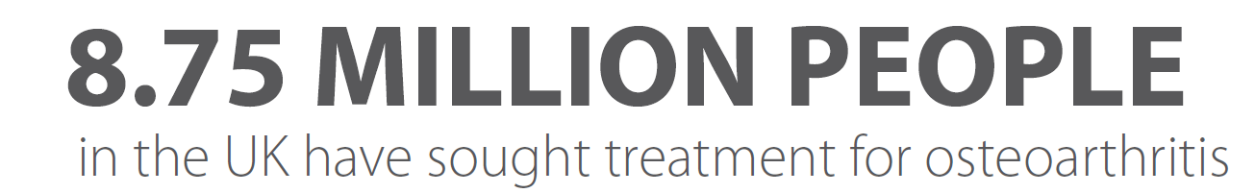
OA in Primary Care
Osteoarthritis (OA) is the most common musculoskeletal condition in older adults in the UK
Around 1/3 of people over the age of 45 have consulted to UK primary care with OA
Neogi et al 2013 Osteoarthritis and Cartilage
Arthritis Research UK 2013: Arthritis in General Practice http://www.arthritisresearchuk.org/support-us/get-involved/naw-infographic.aspx
Notes:
This slide just emphasizes the scale of the problem

Slide 22
In a population of 10,000
160 people have had a hip/knee replacement
490 people consult for OA per year
1550 people consult for OA over seven years
2080 people report joint pain (knee / hip / hand / foot) for three months or more in last year
Notes:
In a town of 10,000 people, 160 people will have had hip or knee joint replacements. 5% will have consulted their GP in the past 12 months, and over 1500 or 15% will have consulted their GP about joint pain in the past 7 years. Amongst those 10,000 people ONE IN FIVE will have reported joint pain in the knee, hip, hand or foot lasting for at least 3 months within a twelve month period.

Slide 23
UK economic burden of OA in 2012
116,000 joint replacements = £850 Million
Indirect costs = £3.5 Billion – work absence, lost economic production, etc.
Source: Chen A et al, Arthritis Vol 2012; Article ID 698709
Notes:
The burden of DISABILITY for the individual affected AND the cost in terms of hours of work lost or in terms of NHS spend is HUGE. In the UK in 2012, £850 million was spent on 116,000 hip and knee replacements and indirect costs of OA, including hours of work lost and loss of economic production, were estimated at £3.5 billion
Source – Office for National Statistics
Original review article: Chen A et al. Arthritis Vol. 2012, Article ID 698709. http://downloads.hindawi.com/archive/2012/698709.pdf

Slide 24
Explaining OA
Notes:
This is a major section, involving some practical skills development. It could occupy about 45 minutes.

Slide 25
Crafting an explanation for patients with OA (Group task 15 mins)
What do patients need to know?
How much information and how long?
How to structure it?
What to emphasise?
Have they understood?
AVOID JARGON!
Notes:
The key to giving effective explanations is to think first “What does the patient need/want to know?” not “What information do I need to get across?” Think about framing it in terms of their health beliefs and level of health literacy. Clinicians often resort to jargon and this can cover up their own lack of a clear understanding about a condition.
Each group could produce a framework for an explanation to try out in the next practical exercise

Slide 26
Try giving your explanation
(Group task in pairs or trios 20 mins)
Not role play – you are a health professional and giving the explanation to a colleague as a try-out
Third person is an observer
Have a quick discussion/feedback then next person can try, incorporating any new ideas generated
Notes:
This is just a simple simulation exercise to try out a structure and form of words that might work with patients. Members of a group may have particular phrases or analogies that they find helpful and that others can learn from. Everyone in the group is a competent/expert practitioner and no one should feel threatened by trying out explanations amongst colleagues – the whole group owns the exercise any no one’s skills are under scrutiny.
Just having a theoretical discussion about the explanations we give or we think we might give just doesn’t work the same, so persuade everyone to give it a go

Slide 27
Giving an explanation
There is no clear tested ‘best’ explanation
Zero tolerance for jargon!
Back it up with written information
Patients want a clear an meaningful diagnosis
Paskins et al 2015
Notes:
The next few slides provide some ideas derived from Keele research

Slide 28

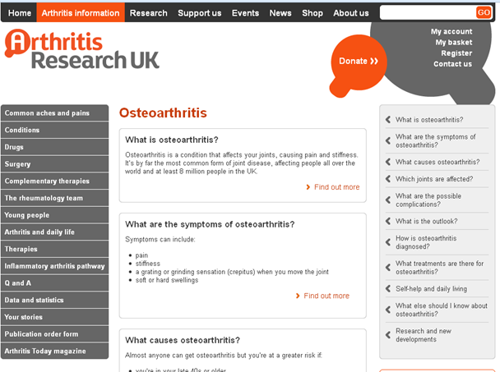
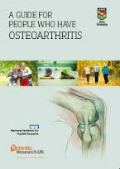



Quality written information
Notes:
A guidebook and Versus Arthritis leaflets (some still badged as ARUK) are helpful. The “Keep Moving” leaflet has a pull-out chart of simple exercises

Slide 29
Essential component:
Osteoarthritis
?
Why?
Caution
Matches:
NICE OA Guideline Patient information
Still needs an explanation….
Notes:
Patient-facing literature, websites, etc. use the label “Osteoarthritis” and patients don’t always know this relates to them unless someone has said they have OA

Slide 30
What patients hear…
What you say …
I don’t want to worry them
You are getting old and have worn your bones out
It’s familiar and understandable
It’s only going to get worse
“Wear and tear”
There is nothing that can be done
Exercise will wear my joints more
Its normal
Drew Moore, Keele Univ. personal communication from MOSAICS study
Paskins et al. Ann Fam Med. 2015; 13(6): 537-44.
Barker et al. Disabil Rhabil. 2013; DOI: 10.3109/09638288.2013.793409
Notes:
So let’s start with the most commonly used phrase “wear and tear”
We think it is used by HCPs because it is unintimidating, reassuring and avoids jargon – Barker et al stated that patients find the phrase approachable and easy to understand, – particularly compared to what is seen as the alternative, and alarming, phrase ‘‘degenerative changes’’
Some people prefer to have a diagnosis as they feel this validates their symptoms – however others feel reassured by a non-medical term
In my work, the term osteoarthritis was recognised as “disastrous” by one GP
However, we know that wear and tear is this is interpreted in a whole host of different ways by patients
Barker found that:
women consistently and strongly tended to respond negatively to the implication that ‘‘wear and tear’’ was a sign of getting old
he term also had unhelpful connotations some several of the participants that arthritis is untreatable or that the GP is not taking their condition seriously
Discussing wear and tear could lead to talking about feelings of guilt or resentment at having pursued enjoyable and healthy activities that were implied to have caused the wear and tear.

Slide 31
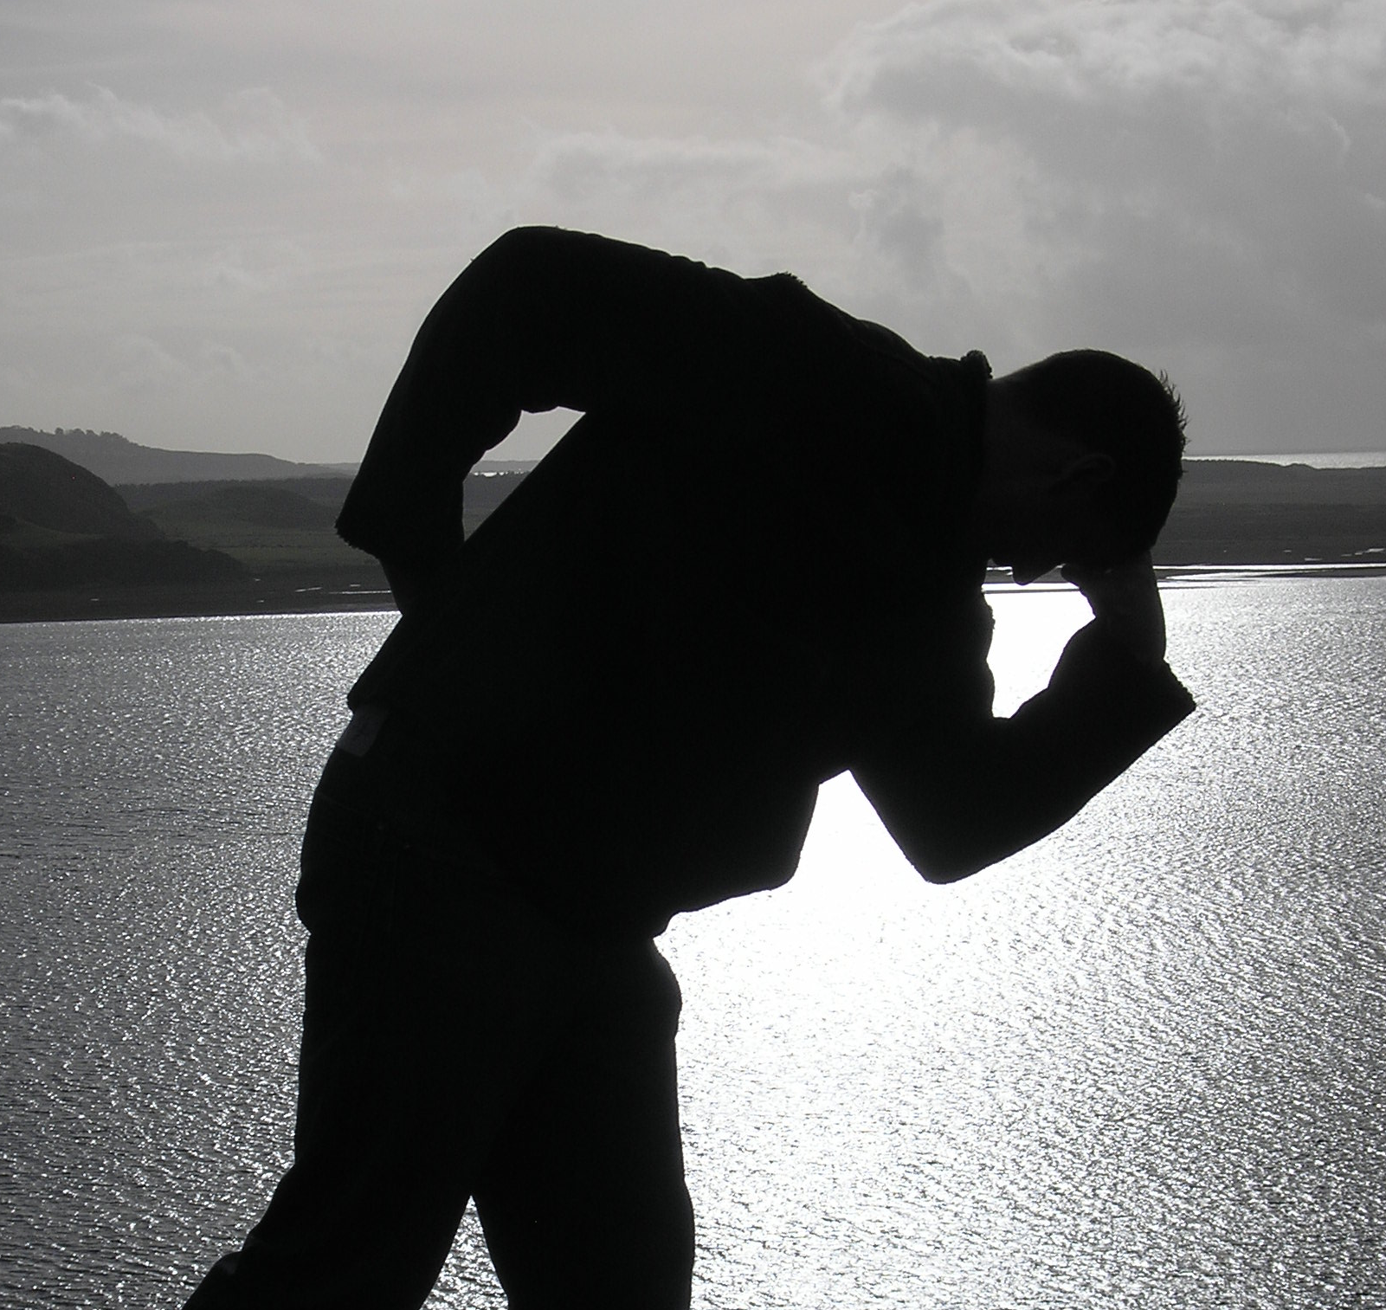
The result of getting it wrong…
Nothing much can be done to help
If I exercise my joints will wear out even quicker
It’s not safe for someone like me to exercise
Rest is best
Notes:
These were some quotes from real patients in our research

Slide 32
Further problems with “wear and tear”
Inaccurate
Neglects likely inflammatory and reparative processes
Too simplistic for this metabolically active condition
Suggests that given adequate longevity we would all get it

Slide 33
What patients hear…
What you say …
“Osteoarthritis”
What does that mean?
Osteoporosis
Thinning of the joints
Less serious than rheumatoid arthritis
Worse than arthritis
Wear and tear
Barker et al. Disabil Rhabil. 2013; DOI: 10.3109/09638288.2013.793409
Notes:
Osteoarthritis is far less familiar term than arthritis
It is often confused with osteoporosis and, linked to this, may be interpreted as thinning of the joints
Some consider it less serious than rheumatoid arthritis.
Others think it may be more serious and more worrying, than arthritis
Some people are very clear that they have osteoarthritis which is the ‘‘wear and tear’’ version of arthritis.

Slide 34
What patients hear…
What you say …
“Wear and repair”
?????
Notes:
“Wear and repair”
However, we don’t really know what patients understand by this

Slide 35
“Wear and repair”
May be more accurate
Still emphasises bone and cartilage
Better concept of “repair” might be “functional repair”:
  restoration of muscle tone
  tightening ligaments
  improved posture & mobility
  …all of which improve function and pain
Notes:
However wear and repair is recommended in Versus Arthritis guidelines as a way of communicating the diagnosis
It is argued it aligns with the concept of flares and episodes of being more settled
Some feel it is a bit clumsy and may still lack clarity
Although there is experimental evidence that cartilage can repair if load is removed – it maintains emphasis on bone and cartilage and current understanding of joints is that it is more than just bone and cartilage
It may therefore be better to think about, and communicate, repair more broadly – for example – strengthening weakened muscles and tightening ligaments and improving poor posture
These process will improve function and reduce pain which can be argued to be a type of repair

Slide 36
Suggested structure for OA explanation
Ask what the patient knows about OA
  May highlight misconceptions
Validate the problem (NOT simple reassurance)
The whole joint
  bone / cartilage / synovium / muscle / ligaments
Stresses to the joint – wear
  injury / sport / work / weight / malalignment
Capable of repair/improvement - not inevitably worse
Something we can do
  strengthen muscles / lose weight / reduce inflammation / help pain
Notes:
The Keele research team proposes that this type of structure could be used
…
However we need to be careful about the language we use to convey this information

Slide 37
Helping patients to manage their OA
And NICE recommendations
Notes:
This is intended as a section of about 45 minutes

Slide 38
Group task with vignette - What are your management goals for him/her?
Use flip chart
Don’t forget impact
Notes:
In a separate MSWord file are 3 short vignettes of patients to consider. The first two are fairly straightforward, whilst the thirs is intended to get participants to think about other conditions and potential red flags. A past history of breast cancer may be relevant; the story of girdle type pain might suggest early stages of PMR. You might need to prompt participants a bit.
In general, we are looking for holistic goals that take account of the patient’s story

Slide 39
NICE OA treatments
oral NSAIDs including COX-2 inhibitors
capsaicin
opioids
intra-articular corticosteroid injections
paracetamol
supports and braces
education, advice,
information access
strengthening exercise
aerobic fitness training
weight loss if overweight/obese
local heat and cold
shock-absorbing shoes or insoles
assistive devices
TENS
topical NSAIDs
manual therapy (manipulation and stretching)
joint arthroplasty
Conaghan BMJ 2008
Notes:
NICE guidance is all evidence-based and reviewed regularly. They condense their recommendations for treating OA in this dart board style diagram. The red bullseye or core is the first line of attack. Supporting patients with education about their condition, giving good advice and access to information are the very first elements of high quality OA care. Strengthening exercises, aerobic fitness training, and weight loss if needed, follow on as core interventions. Further out we find the old favourites of paracetamol and topical NSAIDs. In the outer ring are other options which may be helpful to some and these range from supports, braces, assistive devices, local heat and cold applications, other medications such as capsaicin or oral NSAIDs to joint injections or joint replacement surgery.

Slide 40
Managing OA
Core management
Adjunct to core management
Not recommended
1st line
2nd line
Education to support self-management (written and verbal)
Paracetamol
Oral NSAIDs
Glucosamine or chondroitin
Topical NSAID
COX-2 inhibitors
Local heat or cold
Opioids
Acupuncture
Exercise
(aerobic and muscle strengthening)
Topical capsaicin
Tricyclic agents
Assistive devices
Rubefacients
Supports/braces
IA hyaluronan inject
Weight loss
(if overweight/obese)
Arthroscopic lavage/debridement (unless clear mechanical locking)
TENS
Manipulation/Stretching (hip)
Advice on appropriate footwear
(Lower limb OA - inc shock-absorbing properties)
Intra-articular corticosteroid injections
Joint arthroplasty
Follow-up for all patients with symptomatic OA
NICE Clinical Guideline CG177 Osteoarthritis: Care and management (2014) https://www.nice.org.uk/guidance/cg177
Notes:
This is an alternative way of looking at the core treatments, the adjuncts and things that are not recommended because of lack of evidence for efficacy

Slide 41
Helping patients to manage their OA
Information / education / advice

Slide 42

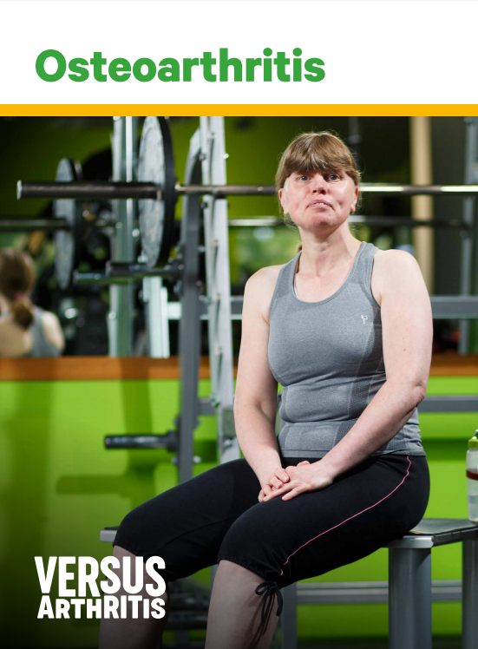


Notes:
One of the central parts of the JIGSAW approach to helping people to help themselves is the Keele Guide for people who have Osteoarthritis.
This booklet was written together with people who have OA. It can be downloaded from the JIGSAW-E website and is also on the Keele Pain Recorder app. It is a super resource for people to dip in and out of.
We have also recently produced a brief 4 page osteoarthritis patient-guide.
Very popular with patients and professionals alike are the Versus Arthritis leaflets for specific joints and the Keep Moving leaflet with its pull out poster demonstrating techniques to exercise various joints. These are free and can be requested from Versus Arthritis (previously known as Arthritis Research UK).

Slide 43
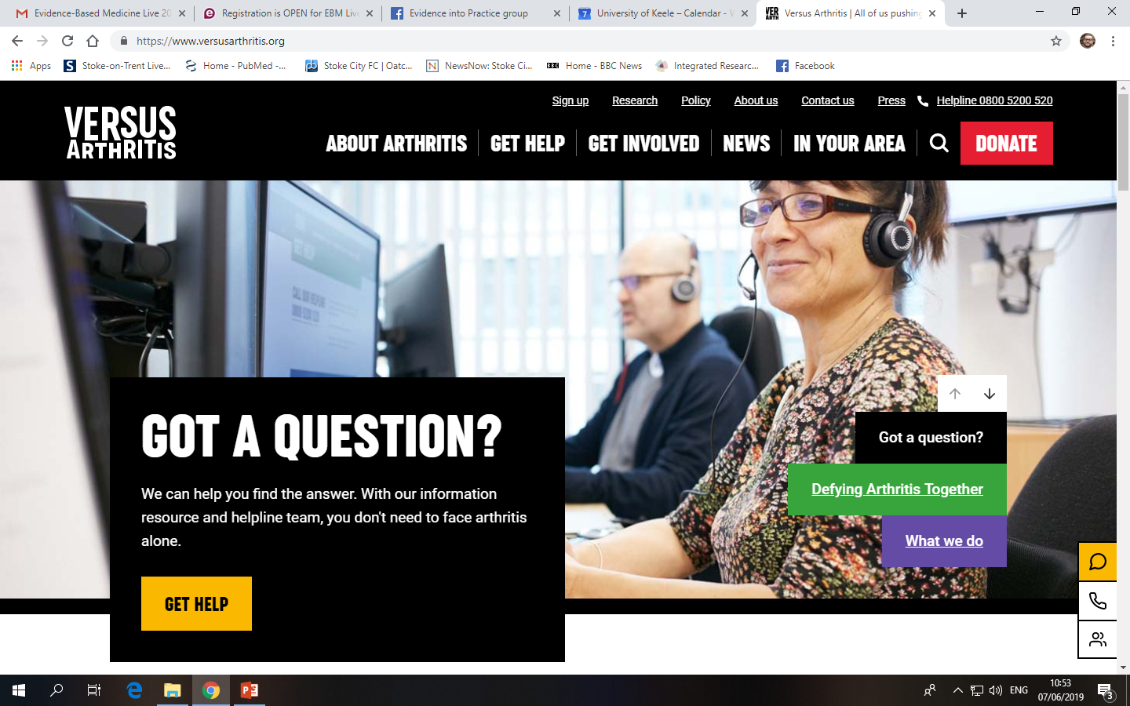
Notes:
The Versus Arthritis website is a good resource for patients

Slide 44
Helping patients to manage their OA
Pain management

Slide 45
Physio role in pain management - 1
You don’t have to be a prescriber to help patients manage pain relief
Self-medication is common esp. Paracetamol
Current move is towards topical NSAIDS and away from opioids and oral NSAIDS
Patients often avoid taking adequate doses – fear of addiction, “keeping in reserve”, side-effects etc.
Notes:
Within the professional boundaries, physios can contribute to medication management. Encouraging patients to take medication as prescribed or to time doses to anticipate exercise or times of worse symptoms can be helpful. It may be important to communicate to the prescriber, issues disclosed by patients, such as side-effects, using “complementary” remedies that may have adverse interactions, alcohol use as an analgesic, etc

Slide 46
Physio role in pain management - 2
Ask about how they use pain relief, how effective and any problems or worries – may need to suggest GP/nurse review
Advise on timing in relation to activity – anticipatory dose can be useful
“Masking pain” and causing damage is a myth
Exercise itself can reduce pain
Advice on non-pharmacological measures

Slide 47
Helping patients to manage their OA
Weight management

Slide 48
Importance of overweight & obesity
Risk factor in developing OA
Vicious cycle of weight gain, immobility, worsening symptoms
Reducing weight improves:
  Pain
  Mobility
  Surgical risk and recovery
Notes:
Physios may have a role in introducing the subject of overweight or reinforcing advice given by others. Giving reasons for weight reduction can be important for understanding and motivation. Signposting to weight reduction services may be beneficial

Slide 49
It’s OK to talk to patients about weight!
Normalise – e.g. “Patients with joint pain often have problems with weight gain and this can make the joint problem worse”
Information giving
  NICE core treatment
  Benefits of weight reduction
Signposting to weight reduction groups/services

Slide 50
Helping patients to manage their OA
Activity and physical exercise

Slide 51
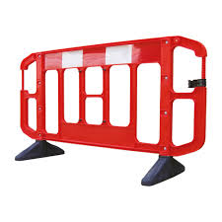
What are the barriers to exercise?
Don’t believe exercise will help them
Fear of falling/pain/ damaging joints further (safety)
Lack of enjoyment
No quick results
Weather
Time
Conflicting advice
Do as I say not as I do?
Notes:
Hendry et al 2006, Holden et al 2012, Dobson 2016 also capability and low Self efficacy beliefs

Slide 52
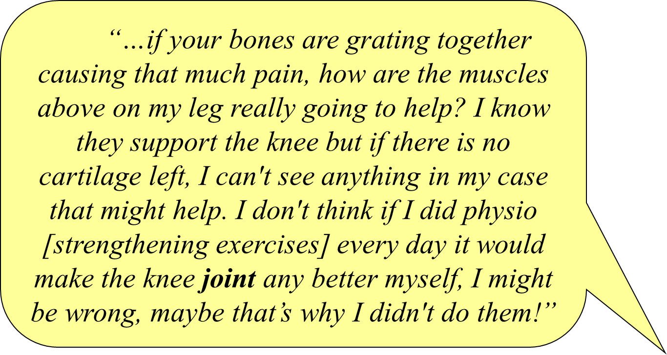
Don’t believe exercise will help?
Notes:
Read…
A key barrier is that for some people they don’t believe exercise can help…I will read you this interview quaotation…

Slide 53
“It seems common sense that if you’ve got a deterioration in the joint like which arthritis is, or, the things in-between the joint, then, the more you do it, the more it’s going to be worn. I wouldn’t have thought it’s something that would get better with practice, you know, with exercise, I wouldn’t have thought that would improve it. If something’s broke in there, then waggling it about can’t do it a lot of good, I wouldn’t have thought.”

Slide 54
Is exercise safe for patients with OA?
“There are few contraindications to the prescription of strengthening or aerobic exercise in patients with hip or knee OA” Roddy et al 2005
“No evidence of serious adverse events, increases in pain, decreases in physical function, progression of structural OA on imaging or increased TKR at group level with therapeutic exercise” Quicke et al 2015
Notes:
Consensus from a group of OA expert clinicians and academics highlighted that…
Whilst a recent systematic review carried out investigating the safety of long term therapeutic exercise revealed…no evidence of serious side effects resulting in death or permanent disability. Long-term exercise did not increase pain at a group level or lead to progression of structural OA compared to non exercise groups.
Accidents such as falls were very rare and a minority of participants reported mild or temporary increases in pain.
No direct evidence concerning specific contraindications to exercise for hip or knee OA

Slide 55
Benefits of exercise and activity
  Physical benefits
Improved balance
Improved strength
Increased walking speed
Reduced stiffness
Cognitive benefits
Improved mood
Higher self-efficacy
  Advantages:
Cheap
Simple
Few side effects
Benefits multiple health conditions
  Other benefits
Reduced pain and use of NSAIDs
Fewer GP consultations
Notes:
So what do you think might be the benefits of exercise and physical activity for people with OA?

Slide 56
Advising exercise in the presence of pain
Offer advice and reassurance
(hurt does not equal harm)
Pharmacological options
Non-pharmacological options
- Heat/ ice
- Footwear
- TENS
Focus on pacing
Notes:
So what tools can we use to help exercise adherence when prescribing exercise in the presence of pain?

Slide 57
Prescribing exercise in the presence of pain: focus on pacing
“Boom”
Activity
level
“Bust”
Time
Notes:
Supported self-management is the goal. Patients often need help deciding how much, how often, how to pace themselves and what to do if they have exceeded their capabilities and worsened symptoms

Slide 58
Prescribing exercise in the presence of pain: focus on pacing
Activity
level
Time

Slide 59
Exercise advice and resources
Keele Pain Recorder app
Chartered Society of Physiotherapists: “Love activity, hate exercise?”
Sheffield aches and pains website
Escape pain
Local resources – walking groups, aquafit, cycling etc
Notes:
These are some useful resources to illustrate with the links:
The Keele pain recorder is a free app for iPhone or Android, with information, links and data recording
The Sheffield Aches and Pains site is a free NHS resource, written and maintained by a GP and MSK lead. It has really good information for professionals and patients, with patient leaflets that can be downloaded/printed
ESCAPE Pain is available as an online resource as well as the face-to-face sessions

Slide 60
Summary of exercise management
Exercise and regular physical activity is recommended for everyone with OA
Exercise has many associated benefits for people with OA and other long-term conditions
We can influence and address many barriers to exercise and regular physical activity such as unhelpful beliefs about exercising

Slide 61
Key messages
OA has a big impact on patients and society
A lot can be done to restore and preserve function – holistic approaches
Surgery is not the outcome for most
Supported self-management is the goal
Good explanations and positive messages from the outset are essential
Link to resources at: https://jigsaw-e.com
Notes:
Here are the key points from the workshop as a whole
The JIGSAW-E website contains a lot of information about our large European project to improve OA care, with references to the original research and a lot of resources that are free to look at and to download and share for the benefit of NHS colleagues and patients

