Slide 1
Supporting Patients with Osteoarthritis
On line training for support staff 2017

Slide 2
Aims of the programme
Raise awareness of the possible impact of osteoarthritis on individuals
Raise awareness of Osteoarthritis and its affect on the body
Raise awareness of the core treatments currently recommended for the effective management of Osteoarthritis

Slide 3
Thoughts to begin?
Pause for thought…
Take a few minutes to think about a patient, friend or relative who has Osteoarthritis
Think how Osteoarthritis affects them, their lives and those around them

Slide 4
How does OA affect an individual?
Pause for thought…
You may find it useful to consider the affects Osteoarthritis has on many aspects of the person and their lives….
Physical wellbeing
Social activity
Emotional
wellbeing
Treatment options
Impact on co-existing health issues

Slide 5
Time to face the facts!
Let’s see what the evidence says about the impact of Osteoarthritis…

Slide 6
The physical impact of Osteoarthritis is very variable
Physical wellbeing
People may describe a variety of symptoms including:
Pain
Joint stiffness especially after rest (sometimes described as gelling)
Reduced joint movement
Muscle weakness
Bony enlargement may occur
Crepitus or noises on moving their joints
Some may have had x-rays with descriptions of ‘OA changes’

Slide 7
The impact on social activity is very variable
Social activity
General mobility and activities may be reduced due to pain affecting all aspects of peoples lives at home, work, hobbies and leisure and even sleep
Symptoms may lead to time off work or being unable to join in with friends and family activities

Slide 8
The emotional impact of OA is very variable
Emotional
wellbeing
The affect on mood and emotions may alter abilities to adjust with coping with pain and altered lifestyles including work
Their may be co-existing conditions of anxiety and depression for people to come to terms with and manage too

Slide 9
Treatment options are variable
Treatment options
Surgery is not inevitable…it is not the only treatment choice
Any recommended treatments should be tailored to individuals needs dependant upon how their lives are affected
There are several vital core elements to address
Education and advice with access to information
Strengthening and aerobic fitness training
Weight management if overweight or obese

Slide 10
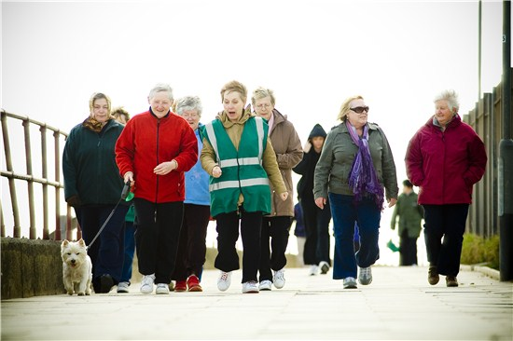
Impact on co-existing health conditions is variable…
Impact on co-existing health issues
Pain may restrict walking and physical activities which often help with other health conditions including diabetes, breathing problems or heart disease

Slide 11
Osteoarthritis?...
Pause for thought…
Before we begin you may find it useful to write down what you understand by Osteoarthritis
From your own impressions and experiences, what do you think are the main concerns of patients with Osteoarthritis?
What do you believe the future holds for individuals with Osteoarthritis?

Slide 12
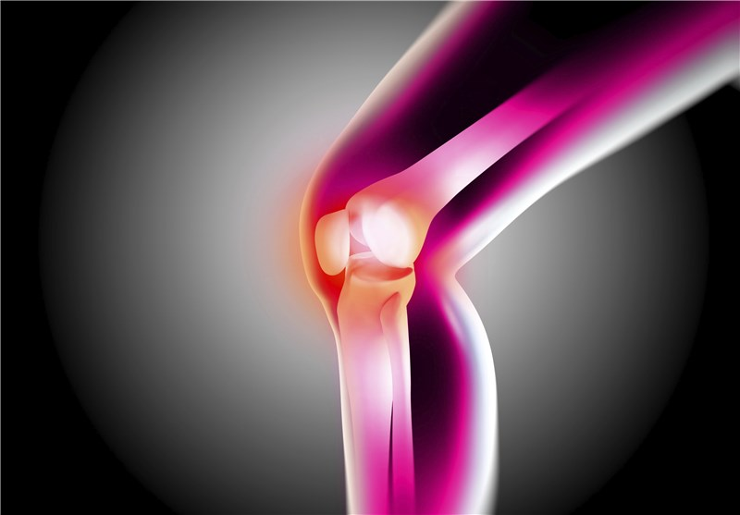
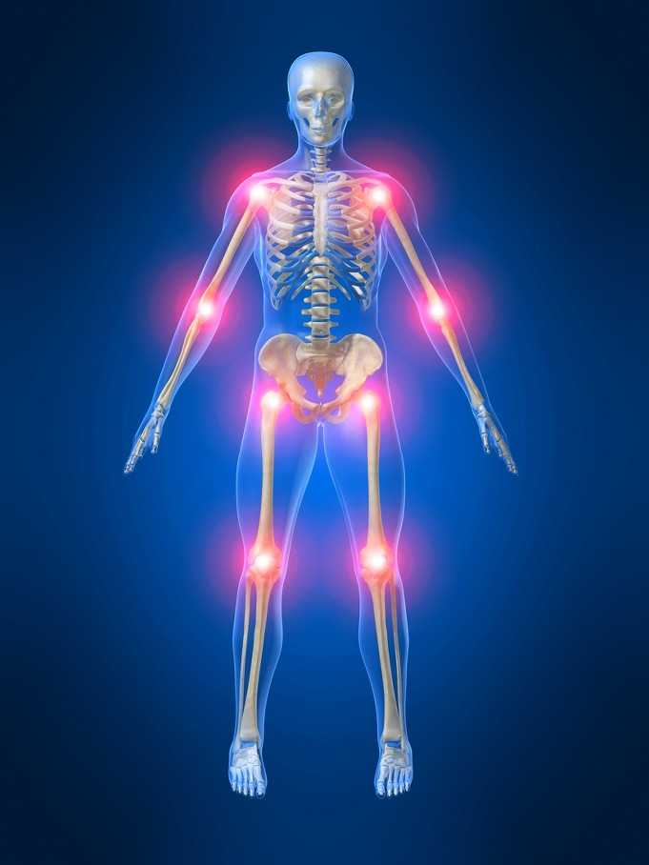
What is Osteoarthritis?
Osteoarthritis is not simply mechanical wearing out of a joint
Although it is commonly referred to as ‘wear & tear’ it is an active condition with the body seeking to repair itself. So the term ‘wear & repair’ is a better description

Slide 13
Busting some myths!

Slide 14
Many people believe Osteoarthritis is inevitably progressive and disabling, and that ‘nothing can be done’

Slide 15
On studying 600 people over 6 years with knee pain due to Osteoarthritis… Less than one third of people have progressive symptoms and knee pain can improve over time!

Slide 16
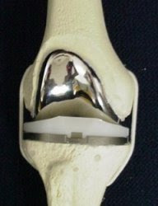
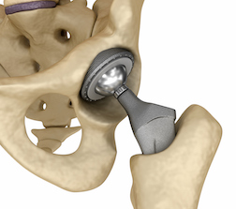
Many people believe that everyone with Osteoarthritis needs joint replacements

Slide 17
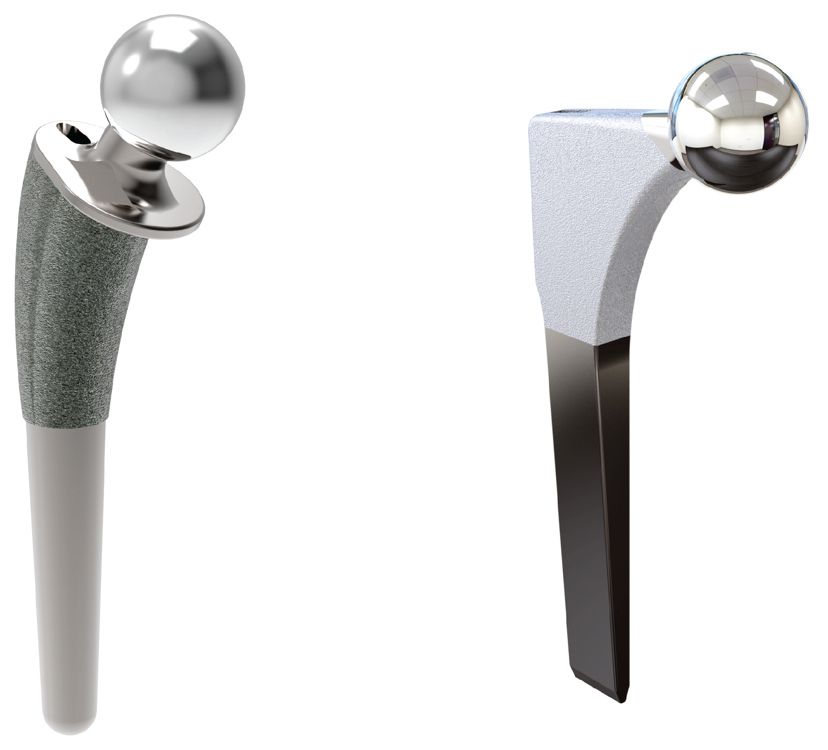
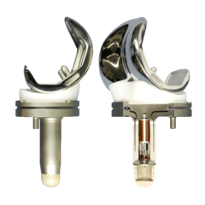
4 years after going to see their GP with hip OA only 25% of patients will have had a hip replacement……. 75% of patients won’t have had a joint replacement
And if a joint replacement is needed it has a good outcome for most patients

Slide 18
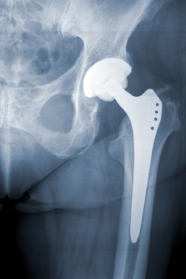

Slide 19
How does a health practitioner diagnose Osteoarthritis?
When an alternative diagnosis is unlikely, for Osteoarthritis of the knee, hip, hand or foot a working diagnosis is made if the person is aged 45 years and over and reports:
Persistent joint pain that is worse with use
Morning stiffness less than half an hour
NB There is no need for X-rays or scans

Slide 20
Explaining osteoarthritis
Once a diagnosis has been made people need to be told in a way that is meaningful to them.
Asking the person what they think their problem is due to and addressing any ideas or concerns is vital
Why is this important?

Slide 21
The importance of an explanation
Fundamental to improving patient outcomes
Affects how people think about their bodies, their pain and ultimately their behaviour
Effective explanation helps with management planning especially lifestyle changes

Slide 22
How should we explain the diagnosis of osteoarthritis?
Ask the person what they think their problem is due to and address any ideas or concerns when chatting through the diagnosis
Use the phrase ‘wear and repair’ it is not simply mechanical wearing out of a joint
Joints try to repair themselves just like all other bodily structures
Pain is a problem but doesn’t mean more damage is occurring
“Use it or lose it” - when not used muscles weaken and make joints less stable
Activity benefits joints, weight and general health and doesn’t make
osteoarthritis worse
Most people with ostoarthritis don’t end up with joint replacement

Slide 23
What is the target of an explanation?
Understand their condition and their future with it
Know it is possible to, and how they can, self-manage their OA
Believe recommended management will work

Slide 24
The result of getting it wrong…
If I exercise my joints will wear out even quicker
It hurts when I move
Nothing much can be done to help
Rest is best
It’s not safe for someone like me to exercise
Notes:
If we do not get explanations right we may be leaving patients with the wrong messages

Slide 25
For any explanation it is important to use the term:
Osteoarthritis
?
Why?
Caution!
Because it matches:
NICE OA Guidelines & Patient information
Still needs an explanation….

Slide 26
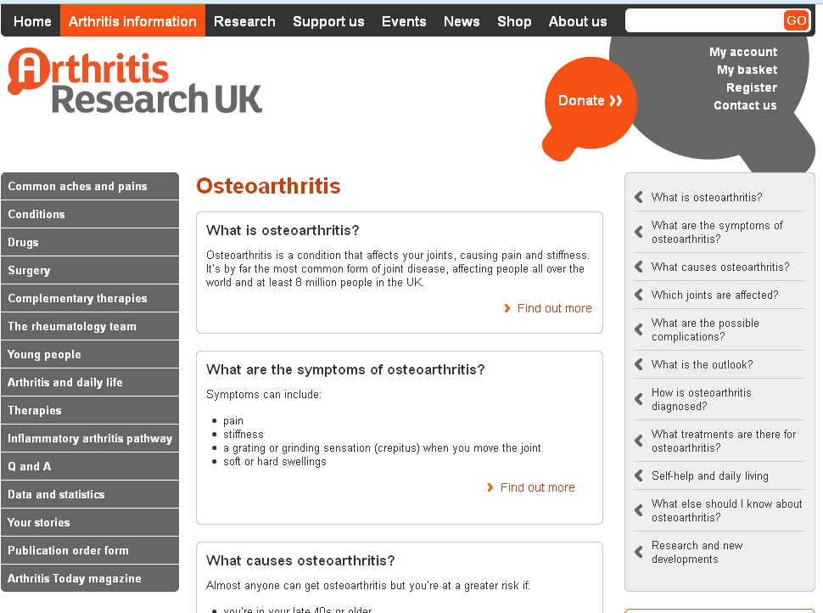
Back it up with written information
Notes:
NICE Guidelines include provision of written information

Slide 27
What patients hear…
What you say …
I don’t want to worry them
You are getting old and have worn your bones out
It’s familiar and understandable
It’s only going to get worse
“Wear and tear”
There is nothing that can be done
Exercise will wear my joints more
Its normal
Drew Moore, Keele Univ. personal communication from MOSAICS study
Paskins et al. Ann Fam Med. 2015; 13(6): 537-44.
Barker et al. Disabil Rhabil. 2013; DOI: 10.3109/09638288.2013.793409
Notes:
So let’s start with the most commonly used phrase “wear and tear”
We think it is used by HCPs because it is unintimidating, reassuring and avoids jargon – Barker et al stated that patients find the phrase approachable and easy to understand, – particularly compared to what is seen as the alternative, and alarming, phrase ‘‘degenerative changes’’
Some people prefer to have a diagnosis as they feel this validates their symptoms – however others feel reassured by a non-medical term
In my work, the term osteoarthritis was recognised as “disastrous” by one GP
However, we know that wear and tear is this is interpreted in a whole host of different ways by patients
Barker found that:
women consistently and strongly tended to respond negatively to the implication that ‘‘wear and tear’’ was a sign of getting old
he term also had unhelpful connotations some several of the participants that arthritis is untreatable or that the GP is not taking their condition seriously
Discussing wear and tear could lead to talking about feelings of guilt or resentment at having pursued enjoyable and healthy activities that were implied to have caused the wear and tear.

Slide 28
What patients hear…
What you say …
“Arthritis”
I have heard of this
I am not quite sure what this means
That means I have damage to cartilage
Barker et al. Disabil Rhabil. 2013; DOI: 10.3109/09638288.2013.793409
Notes:
Arthritis is considered accessible and is commonly used
Patients are familiar term with this
However – they may not be quite sure what it means – some think it may mean both osteoarthritis and rheumatoid arthritis.
Patients sometimes interpret this as ‘‘damage to cartilage’’ and associate it with pain.

Slide 29
What patients hear…
What you say …
“Osteoarthritis”
What does that mean?
Osteoporosis
Thinning of the joints
Less serious than rheumatoid arthritis
Worse than arthritis
Wear and tear
Barker et al. Disabil Rhabil. 2013; DOI: 10.3109/09638288.2013.793409
Notes:
Osteoarthritis is far less familiar term than arthritis
It is often confused with osteoporosis and, linked to this, may be interpreted as thinning of the joints
Some consider it less serious than rheumatoid arthritis.
Others think it may be more serious and more worrying, than arthritis
Some people are very clear that they have osteoarthritis which is the ‘‘wear and tear’’ version of arthritis.

Slide 30
What patients hear…
What you say …
Treatable
Inflammation
Spreading problem
Effusion
Bones are fusing
Degenerative change
My joints are crumbling
Barker et al. Disabil Rhabil. 2013; DOI: 10.3109/09638288.2013.793409
Notes:
Other terms that may have come up include:
Inflammation – this has been found to be is familiar to patients and can be interpreted positively as being treatable e.g. with anti-inflammatories
Effusion – is not familiar to patients can be interpreted as bones fusing together or the problem being likely to spread
Degenerative change is not familiar to patients and was often interpreted negatively – that joints are crumbling and the process is irreversible

Slide 31
Pause for thought…
Try to think how you would explain key messages to someone who has recently been diagnosed with Osteoarthritis of the knee…

Slide 32
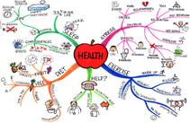
Supporting patients with self-management

Slide 33
Osteoarthritis treatments recommended by NICE guidelines
oral NSAIDs including COX-2 inhibitors
capsaicin
opioids
intra-articular corticosteroid injections
paracetamol
supports and braces
education, advice,
information access
strengthening exercise
aerobic fitness training
weight loss if overweight/obese
local heat and cold
shock-absorbing shoes or insoles
assistive devices
TENS
topical NSAIDs
manual therapy (manipulation and stretching)
joint arthroplasty
Conaghan et al. BMJ 2008;336:502-3

Slide 34
Supporting self-care
Most “care” happens outside of primary care consultations
Own experiences and lay networks are key
Patients manage without health care professionals most of the time
Notes:
This was a real strip of paper scribbled on by a patient with diabetes who said ‘this is me’ the red slashes are when I see people with my LTC but the periods in between are when I need support to help myself.
Making the point that we need to focus on supporting self-care

Slide 35
Supporting self-management of osteoarthritis
Ensure the diagnosis has been made by a health professional and problem is understood with any ideas, concerns discussed and expectations understood
Back up any advice given with good quality written information
Supported to gain the knowledge, skills and confidence to care for their symptoms and limitations in the most effective way
Signposted to appropriate local resources

Slide 36
Local resources
Pause for thought…
Take some time to consider any resources which could help people as they manage their symptoms of osteoarthritis
Are any of these resources available locally?

Slide 38
Pause for thought…

