Slide 1
Enhancing Osteoarthritis Care in
Europe
The JIGSAW-E Project

Slide 2
JIGSAW Project aims to:
Implement NICE OA Guideline more uniformly
  Involve practice nurses and others more in OA care
  Enable and support self-management by patients
Reduce GP workload for OA
Rationalise orthopaedic referrals for OA
  Appropriate patients and timing
  Better prepared for better outcomes
Notes:
Evidence is that implementation of NICE guideline for OA is patchy
In the MOSAICS project, the emphasis was on developing nurses’ knowledge and skills and involve them more in managing OA. There will be 2 days of training for all nurses in this project
There are lots of misguided health beliefs about OA and a generally negative view of prognosis, with little to offer except analgesics and eventual joint replacement. The main thrust of this project is to provide good information, convey a positive outlook and help patients to manage their OA better.
Patients with OA often have other long-term conditions and often consult repeatedly. The management strategy for OA (increased activity and weight management) is also a core treatment for many other conditions
In MOSAICS, nurses were enthusiastic about and good in this enhanced role

Slide 3
The rationale
Epidemiology
Natural history
Impact on patients’ lives
Impact on other long-term conditions
Impact on NHS
Lack of systematic management approach

Slide 4
OA is highly prevalent
In a practice with 10, 000 patients
2080 older people (45y+) report joint pain (knee / hip / hand / foot) for three months or more in last year³
1550 people consult for OA over seven year period²
490 people consult for OA per year²
160 people have had a hip/knee replacement¹
1- Steel Rheumatology 2006, 2- Jordan Ann Rheum Dis 2012, 3-Thomas Rheumatology 2014
Notes:
Next slides present the argument as to why we should try and implement the NICE OA guidance – first OA is highly prevalent
In terms of older people with chronic joint pain – which will be predominantly attributable to OA – about 1/5th of the practice’s patient will be affected
Going back over a seven year period about 1500 patients consult for OA (either coded as OA or, in those aged 45+, as joint pain
And about 500 consult annually
And a small but significant number will have had a hip or knee replacement

Slide 5
OA is a long term condition - not inevitably progressive
Six year pain trajectory in 600 people with knee OA
Mild,
non-progressive
N = 208
Progressive
N = 170
Moderate
N = 137
Improving
N = 65
Severe,
non-improving
N = 20
WOMAC pain (0-20)
Time (in years) since baseline
Nicholls Osteoarthritis Cartilage 2014
Notes:
Second OA is a long term condition – although not inevitably progressive
Data from six year follow up of people in the community (some who have consulted some who have not) shows that OA is an ongoing problem – but for some improves
Nicholls E, Thomas E, van der Windt DA, Croft PR, Peat G. Pain trajectory
groups in persons with, or at high risk of, knee osteoarthritis: findings from
the Knee Clinical Assessment Study and the Osteoarthritis Initiative.
Osteoarthritis Cartilage. 2014 Dec;22(12):2041-50. doi:10.1016/j.joca.2014.09.026.
OBJECTIVE:
The authors aimed to characterize distinct trajectories of knee pain in adults who had, or were at high risk of, knee osteoarthritis using data from two population-based cohorts.
METHOD:
Latent class growth analysis was applied to measures of knee pain severity on activity obtained at 18-month intervals for up to 6 years between 2002 and 2009 from symptomatic participants aged over 50 years in the Knee Clinical Assessment Study (CAS-K) in the United Kingdom. The optimum latent class growth model from CAS-K was then tested for reproducibility in a matched sample of participants from the Osteoarthritis Initiative (OAI) in the United States.
RESULTS:
A 5-class linear model produced interpretable trajectories in CAS-K with reasonable goodness of fit and which were labelled "Mild, non-progressive" (N = 201, 35%), "Progressive" (N = 162, 28%), "Moderate" (N = 124, 22%) "Improving" (N = 68, 12%), and "Severe, non-improving" (N = 15, 3%). We were able to reproduce "Mild, non-progressive", "Moderate", and "Severe, non-improving" classes in the matched sample of participants from the OAI, however, absence of a "Progressive" class and instability of the "Improving" classes in the OAI was observed.
CONCLUSIONS:
Our findings strengthen the grounds for moving beyond a simple stereotype of osteoarthritis as "slowly progressive". Mild, non-progressive or improving symptom trajectories, although difficult to reproduce, can nevertheless represent a genuinely favourable prognosis for a sizeable minority.
Copyright © 2014 The Authors. Published by Elsevier Ltd.. All rights reserved.

Slide 6
Impact on patients’ lives
Pain / disability / increased dependence / social isolation
OA is a barrier to increasing physical activity
Physical effects of inactivity = weight gain, muscle wasting, confidence loss
Affects care of other conditions e.g. DM, IHD COPD
Notes:
There are significant impacts for patients and the NHS
For patients not just about pain – stops them doing the things they need / want to do – walking / part times / activities of daily living; and can lead to increased dependence and social isolation
Barrier to physical activity – knees and hips
So affects management of other long term conditions

Slide 7
Impact on health services
Raising demand for joint replacement surgery
Services offering conservative treatments unable to meet demand
Notes:
Year on year increase in total hip and knee replacements – need figures for hips and knees
NHS does not prioritise services which provide conservative treatments – eg physio / OT

Slide 8
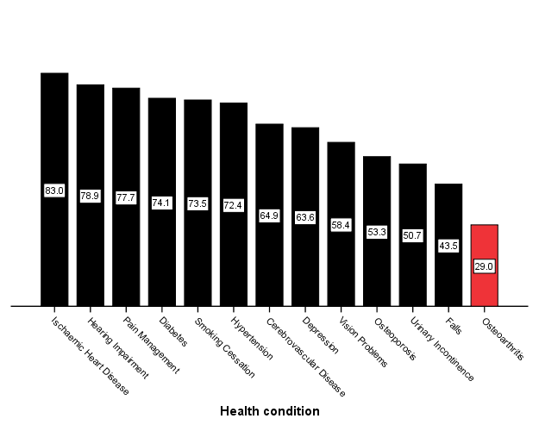
OA is not managed systematically
Proportion of quality indicators met by health condition
Steel et al BMJ 2008
Notes:
OA is not managed in a consistent way as are other conditions – suggest highlight IHD and OA – highest and lowest achevievement of quality indicators
Self reported receipt of care consistent with 32 quality indicators: national population survey of adults aged 50 or more in England
Nicholas Steel, senior lecturer in primary care,1 Max Bachmann, professor of health services research,1 Susan Maisey, research associate,1 Paul Shekelle, director, southern California evidence based practice center,2 Elizabeth Breeze, senior lecturer and English longitudinal study of ageing team,3 Michael Marmot, professor,3 David Melzer, professor of epidemiology and public health4
ABSTRACT
Objective To assess the receipt of effective healthcare interventions in England by adults aged 50 or more with serious health conditions. Design National structured survey questionnaire with face to face interviews covering medical panel endorsed quality of care indicators for both publicly and privately provided care.
Setting Private households across England.
Participants 8688 participants in the English longitudinal study of ageing, of whom 4417 reported diagnoses of one or more of 13 conditions.
Main outcome measures Percentage of indicated interventions received by eligible participants for 32 clinical indicators and seven questions on patient centred
care, and aggregate scores.
Results Participants were eligible for 19 082 items of indicated care. Receipt of indicated care varied substantially by condition. The percentage of indicated care received by eligible participants was highest for ischaemic heart disease (83%, 95% confidence interval 80%to 86%), followed by hearing problems (79%,77%to 81%), pain management (78%, 73% to 83%), diabetes (74%, 72% to 76%), smoking cessation (74%, 71% to 76%), hypertension (72%, 69% to 76%), stroke (65%, 54% to 76%), depression (64%, 57% to 70%), patient centred care (58%, 57% to 60%), poor vision (58%, 54% to 63%), osteoporosis (53%, 49% to 57%), urinary incontinence (51%, 47% to 54%), falls management (44%, 37% to 51%), osteoarthritis (29%, 26% to 32%), and overall (62%, 62% to 63%). Substantially more indicated care was received for general medical (74%, 73% to 76%) than for geriatric conditions (57%, 55% to 58%), and for conditions included in the general practice
pay for performance contract (75%, 73% to 76%) than excluded from it (58%, 56% to 59%).
Conclusions Shortfalls in receipt of basic recommended care by adults aged 50 or more with common health conditions in England were most noticeable in areas associated with disability and frailty, but few areas were exempt. Efforts to improve care have substantial scope to achieve better health outcomes and particularly need to include chronic conditions that affect quality of life of older people.

Slide 9
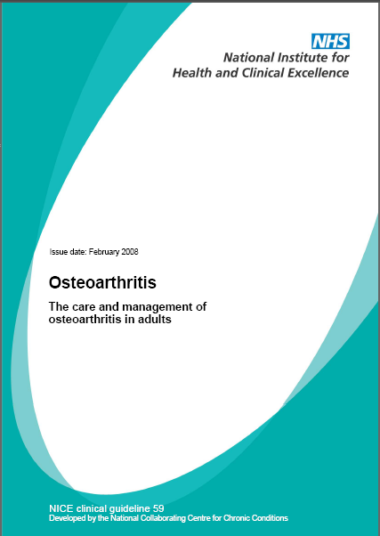
UK NICE OA Guideline: diagnosing OA
  A working diagnosis of OA
  Persistent joint pain with use (knee, hip, hand)
  Age 45 years and over
  Morning stiffness absent or
  less than ½ hour
  An alternative diagnosis is unlikely
Notes:
Key recommendations from NICE OA Guideline are on:
Diagnosis – OA can be diagnosed clinically slides shows NICE’s definition of a working diagnosis of OA

Slide 10
UK NICE OA Guideline: treating OA
oral NSAIDs including COX-2 inhibitors
capsaicin
opioids
intra-articular corticosteroid injections
paracetamol
supports and braces
education, advice,
information access
strengthening exercise
aerobic fitness training
weight loss if overweight/obese
local heat and cold
shock-absorbing shoes or insoles
assistive devices
TENS
topical NSAIDs
manual therapy (manipulation and stretching)
joint arthroplasty
Conaghan BMJ 2008
Notes:
Range of treatments for OA – give brief overview starting from the centre – treatments for all / the first line analgesia / then options for those with ongoing pain and disability

Slide 11
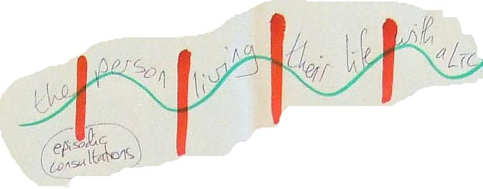
UK NICE OA Guideline: reality of self-care and how to support it
Notes:
NICE recommends a holistic approach which focuses on supporting patients to self-care
The illustration is a true patient representation of living with a chronic condition. This was a real strip of paper scribbled on by a patient with diabetes who said ‘this is me’ the red slashes are when I see people with my LTC but the periods in between are when I need support to help myself.
The NICE guidelines have given us a framework by which to offer this support – information / support on exercise / physical activity / weight loss if needed / first line analgesia

Slide 12
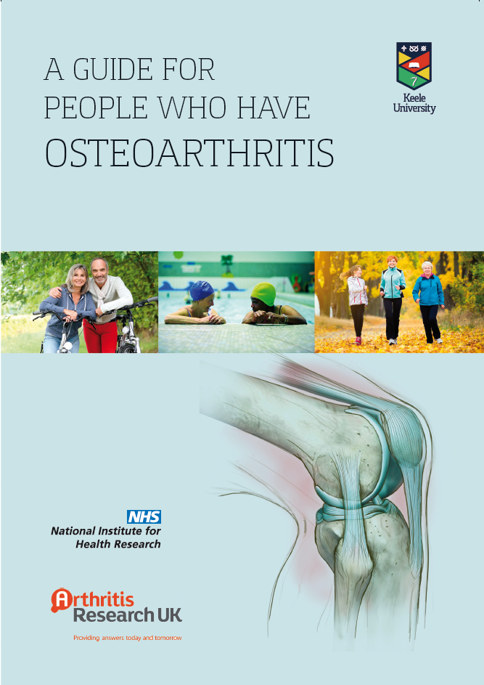
Implementing the NICE OA Guideline
Patient > 45 with joint pain
Enhanced GP consultation
Nurse appointment(s) to support self-care
OA Template
Grime Health Expectations 2011, Dziedzic Implementation Science 2014, Edwards Rheumatology 2015
Notes:
To implement the NICE OA Guideline we adopted this approach in the MOSAICS study
Starting with an older patient presenting with joint pain
GP consultation focused on assessment, diagnosis and initial management plus offering OA guidebook
Nurse appointments to support self-care
Template to prompt and record care

Slide 13
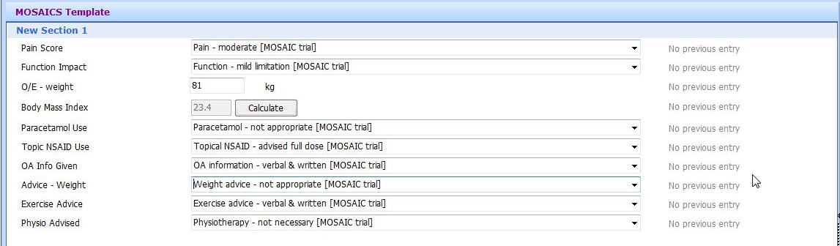
Keele OA Template
Assessment / 1st line analgesia / exercise & weight loss advice / physio referral
Edwards Rheumatology 2015

Slide 14
GP Consultation
Make, give and explain the diagnosis
Address expectations (NB pain relief)
Promote and support self-management
Porcheret BMC Musculoskeletal Disorders 2013

Slide 15
Practice nurse role
Listen to patient’s story and assess:
  Impact of joint symptoms
  Ideas/health beliefs, concerns, expectations
Further explain diagnosis of OA
  Correct unhelpful beliefs
Support self-management:
  Activity and exercise – set realistic goals
  Weight management – help motivate action
  Simple analgesia
  Signpost external resources
Notes:
This provides more detail on the key tasks and is the basis for Day 2 of the nurse training

Slide 16
Practice nurse training
eLearning resource from ARUK/RCGP
Workshop 1
  Background information
  How to help a patient with OA
Workshop 2
  Advising on activity and exercises
  Consulting with patients – practical exercises

Slide 17

The JIGSAW pilot: Much Wenlock and Cressage Medical Practice
8000 patients, 7 GPs, 3 practice nurses
Practice Nurse OA “clinic”
  61 patients over 21 months (3/month)
  36 one appt., 19 two appts., 6 three appts.
  Five orthopaedic referrals for consideration of arthroplasty
Typical 1st appt. with nurse (20-30 mins)
  ASK about: OA understanding / what tried / impact on ADLs
  ADVISE about: analgesia / exercise / wt. loss
  GIVE: Keele OA Guidebook / ARUK “Keep Moving” leaflet
Notes:
Example of “JIGSAW in practice”

