Slide 1

Supporting self-management of OA Physiotherapist workshop
Dr Jonathan Quicke
Professor Krysia Dziedzic
Dr Vincent cooper

Slide 2
Introducing the MOSAICS trial and JIGSAW
Professor Krysia Dziedzic

Slide 3

Implementing osteoarthritis guidelines in UK primary care: MOSAICS cluster randomised controlled trial
To determine the effect of a model OA consultation, informed by NICE OA recommendations, to support self-management in adults aged 45 years and over with peripheral joint pain
Uptake of core NICE recommendations

Slide 4

Evaluation
Clinical effectiveness
SF-12 (PCS) Physical Health
OMERACT/OARSI responder criteria, joint pain intensity, pain self-efficacy, patient enablement
Uptake of core clinical recommendations
Self-reported Quality Indicators of OA care (PPI*)
Electronic medical record review of Quality Indicators of OA care
Cost-consequences and cost-utility
EQ-5D

Slide 5
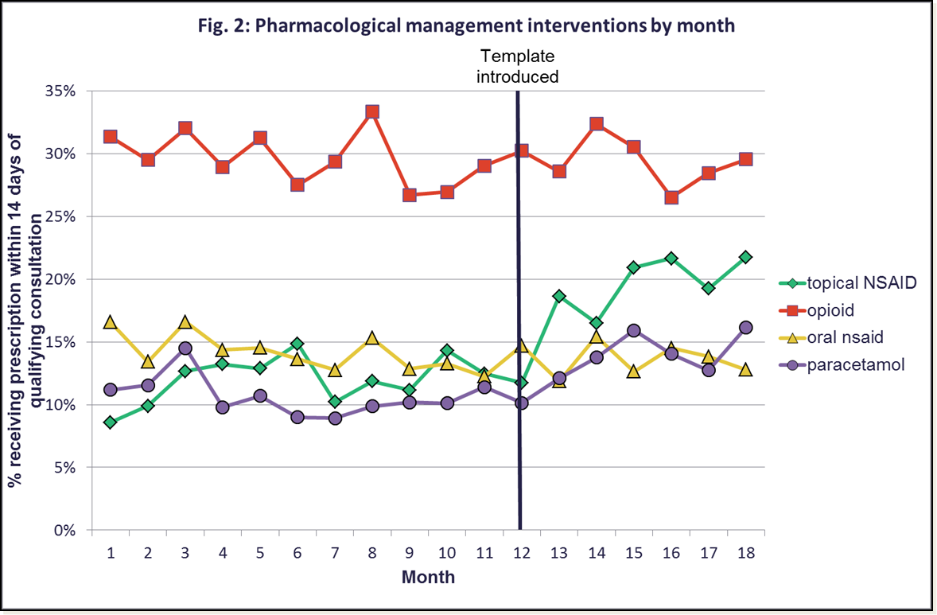
OA Template
Effects on prescribing
Quality Indicator achievement via an OA e-template in primary care
Edwards JJ, et al. Quality of care for OA: the effect of a point-of-care consultation recording template. Rheumatology 2014
Edwards JJ, Jordan KP, Peat G, Bedson J, Croft PR, Hay EM, Dziedzic KS.
Quality of care for OA: the effect of a point-of-care consultation recording template. Rheumatology (Oxford). 2015 May;54(5):844-53.

Slide 6

MOSAICS
8 General Practices
North West Midlands and South Cheshire
Population survey
Self reported joint pain
Hip, Knee, Hand, Foot
Uptake of core NICE recommendations
N=30,000 45 years and over
Consultation for joint pain (OA or at risk of OA)
Consent to follow up
Permission for medical record review
OA Research Users Group [PPI]
NIHR CRN Primary Care West Midlands, Keele CTU

Slide 7
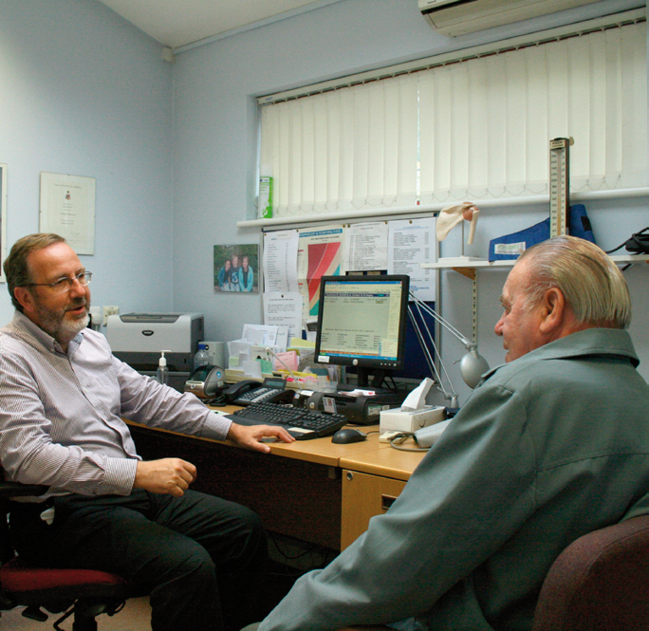
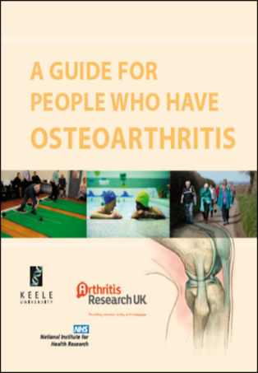
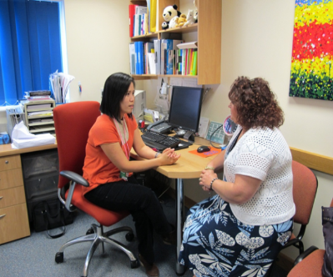
Intervention practices
OA Guidebook
GP and Nurse Training
Model OA consultation
MOAC-1 first consultation with a GP
MOAC-2 follow up consultation(s) with a practice nurse
Patient presenting with joint pain

Slide 8
Model OA Consultation
GP makes, gives, explains diagnosis, analgesia, promotes self-management, gives guidebook, refers to nurse
Practice Nurse supports self-management; guidebook; goal setting, exercise, weight loss, pain control
Patient presenting with joint pain 45 years and over
Porcheret M, et al. Developing a model osteoarthritis consultation: a Delphi consensus exercise. BMC Musculoskelet Disord. 2013 Jan 16;14:25.
Finney A, et al. Defining the content of an opportunistic osteoarthritis consultation with primary health care professionals: a Delphi consensus study. Arthritis Care Res. 2013 Jun; 65(6): 962-8.
Porcheret M, Main C, Croft P, McKinley R, Hassell A, Dziedzic K. Development of a behaviour change intervention: a case study on the practical application of theory. Implement Sci. 2014 Apr 3;9(1):42.

Slide 9

OA Guidebook
‘to actually give them that [core treatment] backed up with written information I really think that makes a difference to the impact’ (GP)
‘they’d read a little bit about what we were going to do prior to coming to see me so all I did was sort of reinforce the information so that was good’ (Practice Nurse)
Morden A, Jinks C, Ong BN, et al. Acceptability of a 'guidebook' for the management of Osteoarthritis: a qualitative study of patient and clinician's perspectives. BMC Musculoskelet Disord. 2014 Dec 13;15:427.

Slide 10
Summary
Model OA consultation
improves what’s important to patients OA care
implements guidelines in primary care
reduces NSAIDS and orthopaedic visits
no additional cost
Integrated GP and practice nurse consultation
support for self-management

Slide 11

80 year old lady
‘She said her husband wouldn’t let her do anything. If the doorbell rang .. ‘sit there you mustn’t move you’ve got osteoarthritis’. When she came to me and I said I want to get you moving she was over the moon it was like a new lease of life..’
‘She’d got her guidebook - she used it quite a lot’
‘At her final consultation she virtually skipped into the room. It was just brilliant to see her because she’d done so well.’
Julie Broad, Nurse Practitioner, Autumn Conference 2013

Slide 12

80 year old lady
‘She said her husband wouldn’t let her do anything. If the doorbell rang .. ‘sit there you mustn’t move you’ve got osteoarthritis’. When she came to me and I said I want to get you moving she was over the moon it was like a new lease of life..’
‘She’d got her guidebook - she used it quite a lot’
‘At her final consultation she virtually skipped into the room. It was just brilliant to see her because she’d done so well.’
Julie Broad, Nurse Practitioner, Autumn Conference 2013

Slide 13
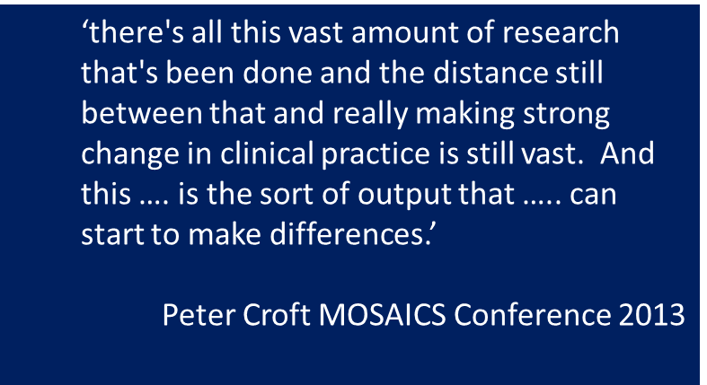
MOSAICS Conference

Slide 14

Shropshire CCG
‘The MOSAICS study generated grass roots interest and support, with GPs and practice nurses reporting greater confidence in managing OA and patients feeling that their joint problems are taken seriously.’
‘In addition, the health professionals realised that the core management principles for OA are the same as those for other long-term conditions (LTCs) and that the knowledge and skills they developed were transferable across a range of LTCs.’
NHS England: OA Regional Innovation Fund
JIGSAW – Regional Innovation Fund Joint Implementation of Guidelines for oSteoArthritis in the West Midlands

Slide 15


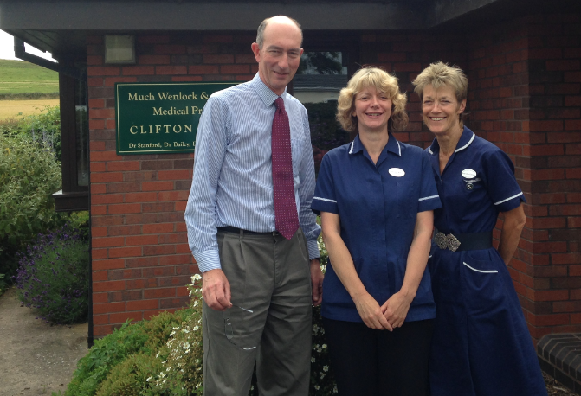
JIGSAW pilot site
GP makes, gives, explains diagnosis, analgesia, promotes self-management, gives guidebook, refers to nurse
Practice Nurse supports self-management; guidebook; goal setting, exercise, weight loss, pain control
Patient presenting with joint pain 45 years and over
Joint Implementation of Guidelines for oSteoArthritis in the West Midlands JIGSAW

Slide 16
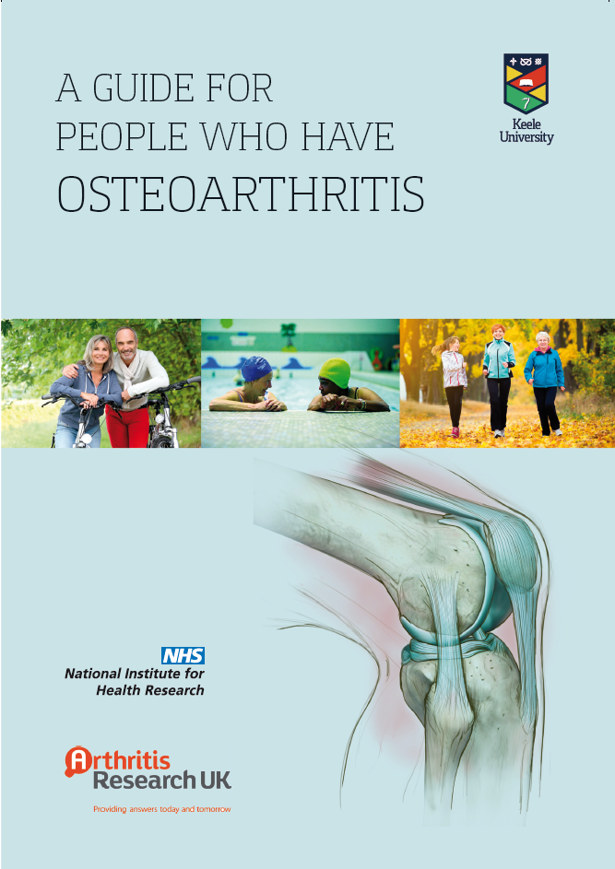
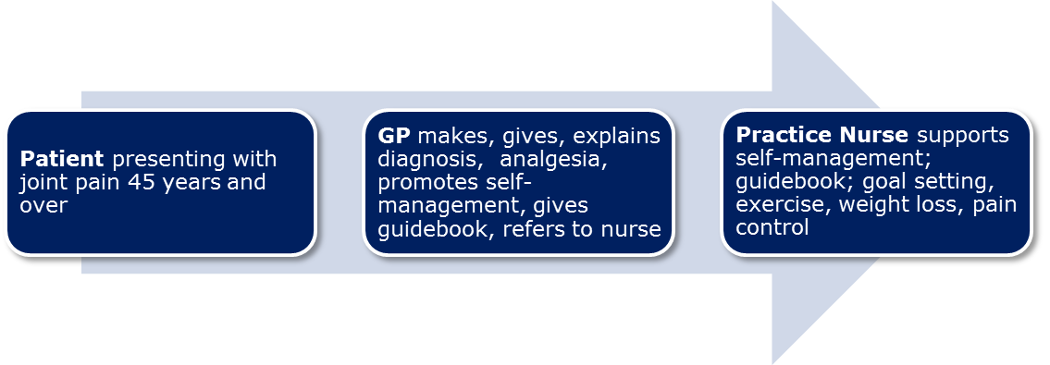
Key innovations
Keele OA Guidebook
GP and Nurse Training
Model OA Consultation

Slide 17

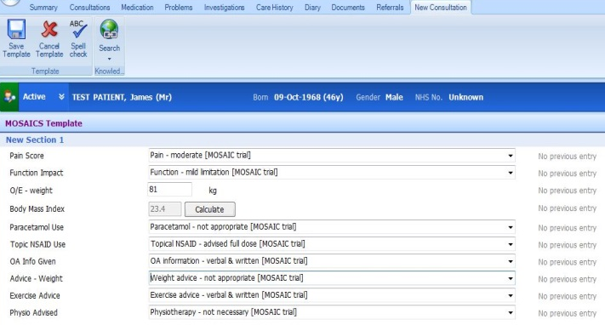
Quality Standard [QS87]
June 2015
Statement 1. Adults aged 45 or over are diagnosed with OA clinically without investigations if they have activity‑related joint pain and any morning joint stiffness lasts no longer than 30 minutes.
Statement 2. Adults newly diagnosed with OA have an assessment that includes pain, impact on daily activities and quality of life.
Statement 3. Adults with OA participate in developing a self‑management plan that directs them to any support they may need.
Statement 4. Adults with OA are advised to participate in muscle strengthening and aerobic exercise.
Statement 5. Adults with OA who are overweight or obese are offered support to lose weight.
Statement 6. Adults with OA discuss and agree the timing of their next review with their primary healthcare team.
Statement 7. Adults with OA are supported with non‑surgical core treatments for at least 3 months before any referral for consideration of joint surgery.
Statement 8. Healthcare professionals do not use scoring tools to identify which adults with OA are eligible for referral for consideration of joint surgery

Slide 18




Østerås N, et al Self-reported quality care for knee osteoarthritis: comparisons across Denmark, Norway, Portugal and the UK. RMD Open. 2015 Oct 20;1(1):e000136.

Slide 19









This presentation presents independent research funded by the National Institute for Health Research (NIHR) under its Programme Grants for Applied Research Programme (Grant Reference Number: RP-PG-0407-10386.) The views expressed are those of the author(s) and not necessarily those of the NHS, the NIHR or the Department of Health. KD is part funded by the National Institute for Health Research (NIHR) Collaborations for Leadership in Applied Research and Care West Midlands and by a Knowledge Mobilisation Research Fellowship (KMRF-2014-03-002) from the NIHR. Acknowledgements: NIHR CRN Primary Care West Midlands, Arthritis Research UK, Arthritis Care, Primary Care Consortium Board, the OA Research Users Group, the network, nursing, health informatics and administrative staff at the Arthritis Research UK Primary Care Centre, the participating general practices and NHS managers, the MOSAICS & JIGSAW teams and funders, our European collaborators
Acknowledgements
Regional Innovation Fund
NHS England Shropshire CCG
CLAHRC
West Midlands
Notes:
19
19

Slide 20
Supporting self-management of OA Physiotherapist workshop
Dr Jonathan Quicke
Professor Krysia Dziedzic
Dr Vincent cooper

Slide 21
Focus on a person you know (Pairs discussion, 15 min)
Think of someone you know with OA – patient, friend, relative
Describe that person to your neighbour and hear his/her account of a person too:
Their life and aspirations
What you think OA means to them?
What impact does it have on their life?
What do you feel about it?

Slide 22
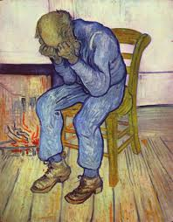
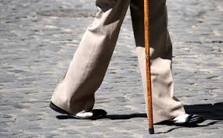
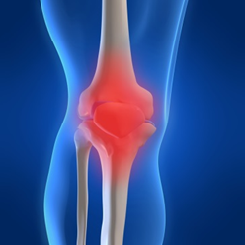


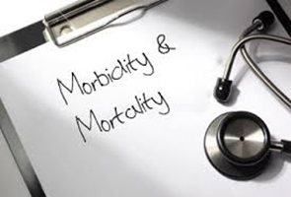
OA impact on the person
Notes:
So looking at impact of OA on the person
…well…it is a major source of disability with lower limb OA associated with slower walking speeds and difficulty with stairs…
Furthermore older adults with lower limb OA are more likely to fall which can be responsible for major health consequences such as hip fractures and premature death (Scott et al 2012, Marlene Fransen 2014)
Perhaps linked to reduced mobility older adults with knee pain are more likely to have 4 or more comorbidities (Fransen et al 2014)…and reduced social participation (Ross Wilkie 2007).
Considering mental health, OA is associated with lower quality of life and higher levels of depression.
…And that is before considering the economic cost of healthcare, days lost to work, and surgery. The problem of knee pain in older adults is far reaching….

Slide 23
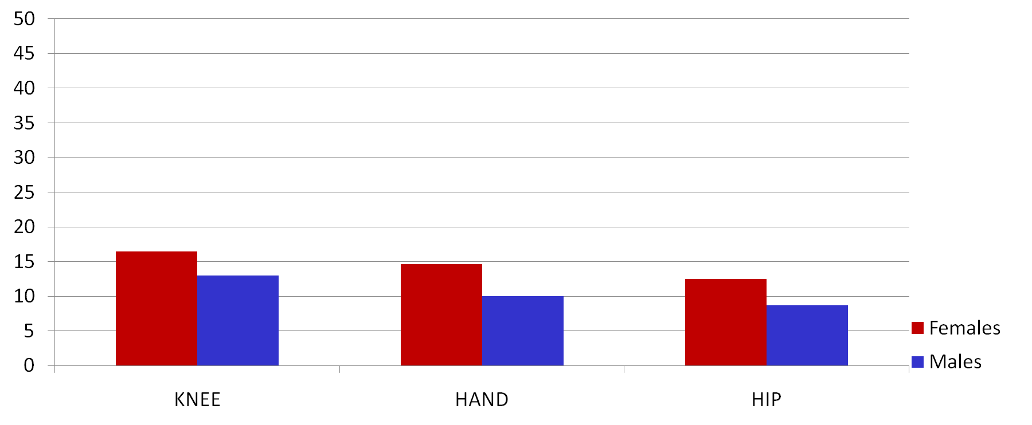
How common is it? - chronic interfering knee, hand and hip pain
Interfering joint pain lasting for more than three months in the past year in those aged 50 years or over
%
16% FOOT (pain lasting 1m) aged 65 yrs
Thomas E. et al, 2004; Dziedzic K. et al, 2007; Thomas M. et al 2011

Slide 24
How does OA present?

Slide 25
Natural History of OA – what do you think? (Pairs discussion 10 min)
What is the cause of OA?
Why does it affect people differently?
How does it affect people?
What can you say about the outlook for someone with OA?
Does anything make a difference to the outcome?

Slide 26
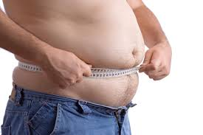
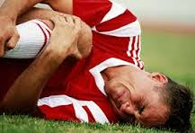

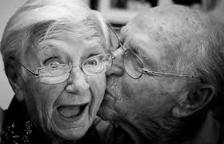
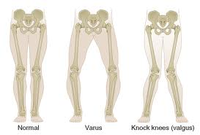

The risk factors contributing to OA onset are complex
Notes:
Many factors combine to contribute to the onset of osteoarthritis and knee pain in older adults. These are well summarised by Melicia’s systematic review but in summary…
Common risk factors associated with knee arthritis onset include previous knee injury, increased BMI, knee mal alignment (both bow legs and knock knees), older age, female gender and some genetic factors.
However, risk factors for onset are not the same as factors for progression which have been less conclusive in the literature.
Arthritis in multiple joints and knee malalignment are the only factors that have been consistently linked with condition progression.

Slide 27
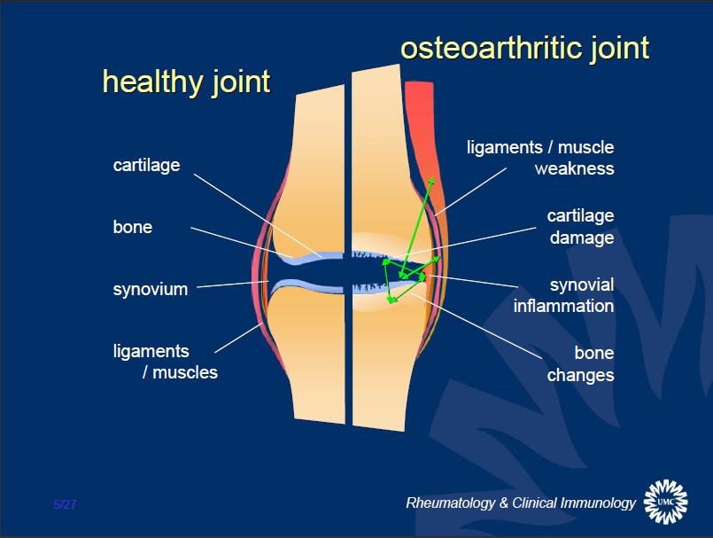
The Underlying Problem – Complex
© Floris Lafeber
Notes:
Complex not fully understood…explain OA changes…whole joint including surrounding musculature

Slide 28
The Underlying Problem – Modifiable
Remove / reduce stressors
Rx inflammation / muscle weakness / joint laxity / malalignment
Address psycho-social issues
Joint capable of repair
© Floris Lafeber
Notes:
Many aspects of OA are modifiable…

Slide 29
OA natural history
Not progressive for everyone (but flares common)
Level of pain and disability can be significant for some
Joint replacement is not the eventual outcome for most patients
Notes:
Summary points re OA natural history

Slide 30
The natural history of knee OA (n=600)
Mild,
non-progressive
N = 208
Progressive
N = 170
Moderate
N = 137
Improving
N = 65
Severe,
non-improving
N = 20
WOMAC pain (0-20)
Time (in years) since baseline
Nicholls Osteoarthritis Cartilage 2014
Notes:
Figure shows the knee pain trajectories of 600 people aged 50 and over with knee pain who responded to a community survey. WOMAC pain is a measurement of pain on activity which sums the scores from five questions: no pain (0) to severe pain (4). Further details in abstract below. Similar pattern is seen in hip OA other than for hip OA there is a rapidly progressive group.
Slide to illustrate that OA is not inevitably progressive, and in some pain improves over time, but for some there is severe ongoing pain.
Nicholls E, Thomas E, van der Windt DA, Croft PR, Peat G. Pain trajectory groups in persons with, or at high risk of, knee osteoarthritis: findings from the Knee Clinical Assessment Study and the Osteoarthritis Initiative. Osteoarthritis Cartilage. 2014 Dec;22(12):2041-50. doi:10.1016/j.joca.2014.09.026.
OBJECTIVE:
The authors aimed to characterize distinct trajectories of knee pain in adults who had, or were at high risk of, knee osteoarthritis using data from two population-based cohorts.
METHOD:
Latent class growth analysis was applied to measures of knee pain severity on activity obtained at 18-month intervals for up to 6 years between 2002 and 2009 from symptomatic participants aged over 50 years in the Knee Clinical Assessment Study (CAS-K) in the United Kingdom. The optimum latent class growth model from CAS-K was then tested for reproducibility in a matched sample of participants from the Osteoarthritis Initiative (OAI) in the United States.
RESULTS:
A 5-class linear model produced interpretable trajectories in CAS-K with reasonable goodness of fit and which were labelled "Mild, non-progressive" (N = 201, 35%), "Progressive" (N = 162, 28%), "Moderate" (N = 124, 22%) "Improving" (N = 68, 12%), and "Severe, non-improving" (N = 15, 3%). We were able to reproduce "Mild, non-progressive", "Moderate", and "Severe, non-improving" classes in the matched sample of participants from the OAI, however, absence of a "Progressive" class and instability of the "Improving" classes in the OAI was observed.
CONCLUSIONS:
Our findings strengthen the grounds for moving beyond a simple stereotype of osteoarthritis as "slowly progressive". Mild, non-progressive or improving symptom trajectories, although difficult to reproduce, can nevertheless represent a genuinely favourable prognosis for a sizeable minority.
Copyright © 2014 The Authors. Published by Elsevier Ltd.. All rights reserved.

Slide 31
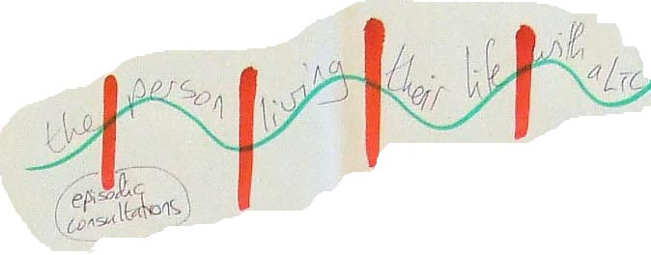
The Patient’s Perspective
Self-management happens outside of healthcare consultations
The patient’s experiences and lay networks are equally valid
Notes:
What we have here is a true patient representation of living with a chronic condition. This was a real strip of paper scribbled on by a patient with diabetes who said ‘this is me’ the red slashes are when I see people with my LTC but the periods in between are when I need support to help myself. The NICE guidelines have given us a framework by which to offer this support. The areas for self management.

Slide 32

Notes:
Refreshment and coffee break

Slide 33
Explanations, myth busting and advice

Slide 34
What do you need to explain?
Which words may not be so helpful?
Notes:
Wear flare repair, whole joint, positive messages regarding natural history and rx options… there are things we can do
Avoid…degenerate/ bone on bone/ joints of an 80 year old etc care with wear and tear and also with messages of avoidance

Slide 35
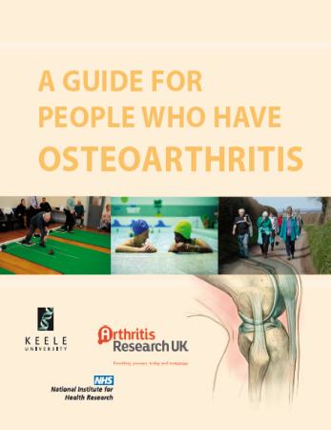



Back it up with written information
Notes:
NICE Guidelines include provision of written information…

Slide 36
Common OA misconceptions
“Wear and tear” condition
A progressively “degenerative” condition
Nothing can be done
Changes on x-ray explain symptoms
Holden, M. A., Nicholls, E. E., Young, J., Hay, E. M., & Foster, N. E. (2012). Role of exercise for knee pain: what do older adults in the community think? Arthritis Care & Research, 64(10), 1554–64.
NICE 2014, Osteoarthritis: Care and management in adults. CG 177.
Notes:
Wear flare and repair…active process of ongoing remodelling
Varied path with some progressing but many staying ISQ, fluctuating and improving
Plenty of effective rxs…many together may have a additive effect
Some pts have notable x ray changes and no symptoms and some have minimal signs and marked pain

Slide 37
“Wear and tear” – what people with OA think we mean
It’s nothing to worry about, it’s a natural process
You are getting old and have worn your bones out
It’s an irreversible process that will only get worse
I don’t know how to treat you
I’m not bothered and neither should you be
There’s nothing we can do.
Drew Moore, Keele Univ. personal communication from MOSAICS study
Notes:
This seems to be doctors’ preferred term
Possibly, we intend it to be reassuring
The alternative “wear and repair” is probably a more accurate description
The guidelines and most useful patient information literature are labelled “Osteoarthritis” – shouldn’t we be open and honest?

Slide 38
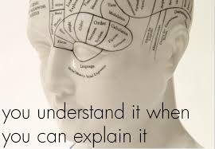
Practise explaining OA
(Pairs or threes discussion 10 min)
Notes:
Care with jargon/ language that may be unhelpful…aim to facilitate positive behaviour with your explanation.

Slide 39

Notes:
Lunch time

Slide 40
The management of OA

Slide 41
NICE Core Treatments for OA
oral NSAIDs including COX-2 inhibitors
capsaicin
opioids
intra-articular corticosteroid injections
paracetamol
supports and braces
education, advice,
information access
Strengthening and aerobic exercise
weight loss if overweight
local heat and cold
shock-absorbing shoes or insoles
assistive devices
TENS
topical NSAIDs
manual therapy (manipulation and stretching)
joint arthroplasty
Notes:
Focus on core management

Slide 42

What are the barriers to exercise?
Don’t believe exercise will help/ conflicting advice
Fear of falling/pain/ damaging joints further (safety)
Lack of enjoyment
Other health problems
No quick results
Weather
Time
Dobson F, Bennell, K. L., French, S. D., Nicolson, P. J., Klaasman, R. N., Holden MA, et al (2016) Barriers and Facilitators to Exercise Participation in People with Hip and/or Knee Osteoarthritis: Synthesis of the Literature Using Behavior Change Theory. American Journal of Physical Medicine Rehabilitation. 95(5):372-89.
Quicke, J. G., Foster N. E., Ogollah R. O, Croft P. C., Holden M.A., (2016 epub ahead of print). Attitudes, beliefs and physical activity in older adults with knee pain: Secondary analysis of a randomised controlled trial. Arthritis Care and Research
Notes:
So what do you think are the barriers to patients carrying out exercise?
…A number of researchers have sought the attitudes and beliefs of adults with joint pain to see what are some of the barriers to carrying out exercise with OA. Some of the common reasons are…
Hendry et al 2006, Holden et al 2012, Dobson 2016 also capability and low Self efficacy beliefs

Slide 43
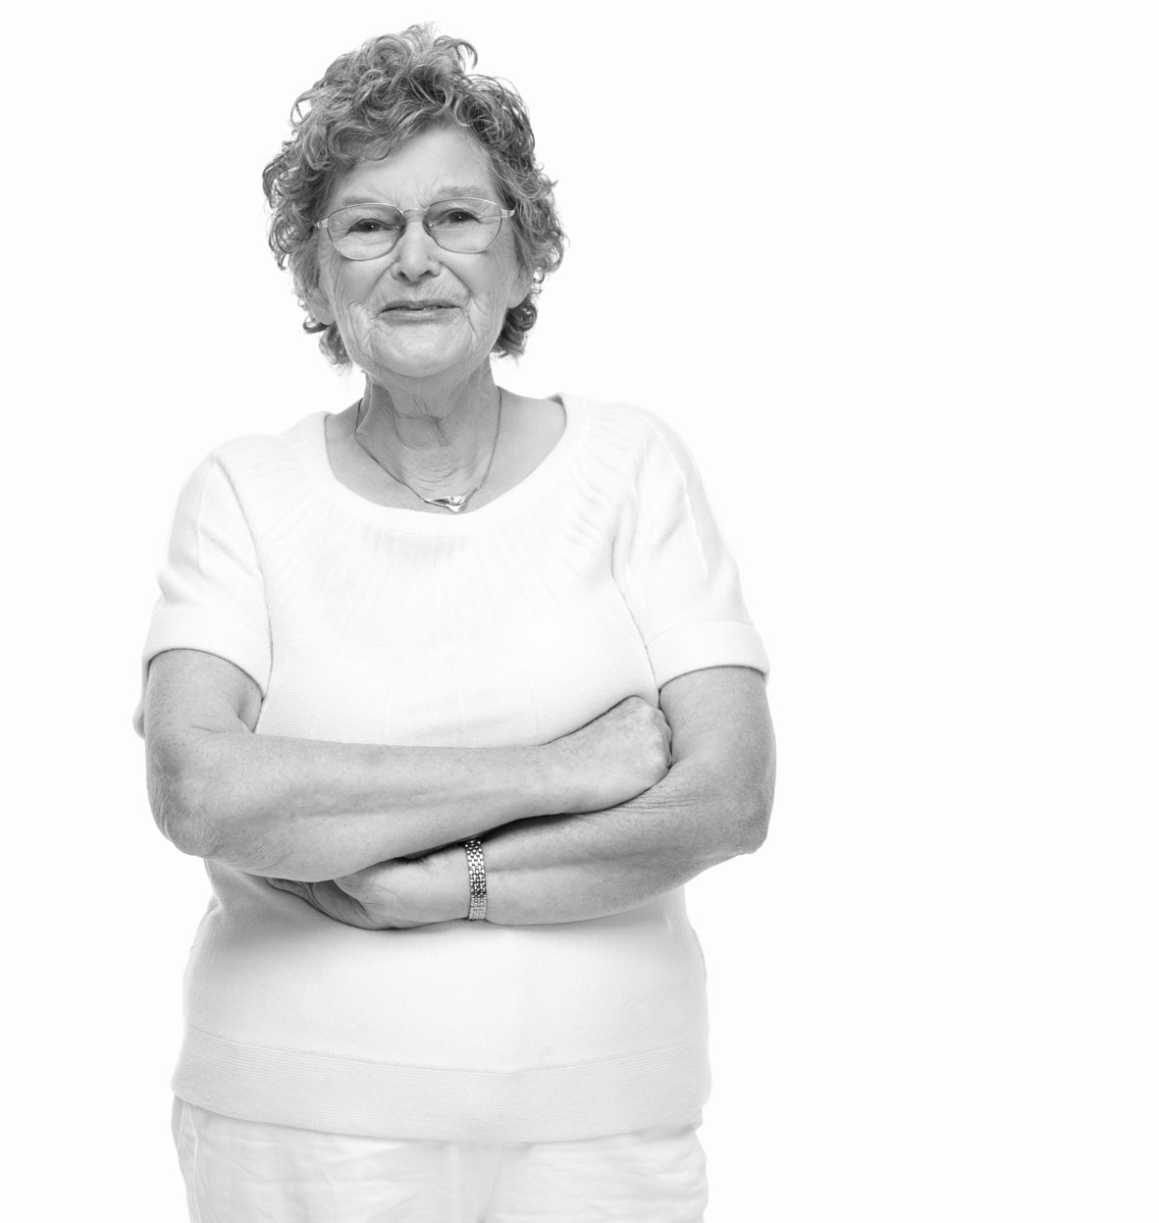
It hurts when I move
If I exercise my joints will wear out even quicker
Nothing much can be done to help
Rest is best
It’s not safe for someone like me to exercise
Notes:
Read…do these concerns sound familiar to you? Do we as physios ever reinforce these beliefs?

Slide 44
Will exercise and activity worsen OA and is it safe?
Notes:
So another key barrier for some patients is the question “will exercise and activity worsen OA?”

Slide 45
Exercise for OA: the evidence
Many national and international guidelines are available for the management of OA and all recommend exercise
“Exercise should be a core treatment for people with osteoarthritis, irrespective of age, co-morbidity, pain severity or disability”
NICE 2014
Notes:
Well what do our best practice guidelines say…
Read verbatim
Does any part of these recommendations sound surprising to you?

Slide 46
The safety of exercise for OA
“There are few contraindications to the prescription of strengthening or aerobic exercise in patients with hip or knee OA” Roddy et al 2005
“No evidence of serious adverse events, increases in pain, decreases in physical function, progression of structural OA on imaging or increased TKR at group level with therapeutic exercise” Quicke et al 2015
Roddy E, Zhang W, Doherty M, Arden N.K, Barlow J, Birrell F et al (2005). Evidence-based recommendations for the role of exercise in the management of osteoarthritis of the hip or knee-the MOVE consensus. Rheumatology, 4(1),67-73.
Quicke, J. G., Foster, N. E., Thomas, M. J., & Holden, M. A. (2015). Is long-term physical activity safe for older adults with knee pain?: a systematic review. Osteoarthritis and Cartilage, 23(9), 1445–1456.
Notes:
A consensus of experts came to the conclusion that there are few contraindications to exercising with lower limb OA…unstable angina…
We also conducted a large systematic review of RCTs that investigated long term- exercise for older adults with knee pain attributed to OA. We found no evidence of serious adverse events described as disabling or life threatening. The most common moderate adverse event was falls in 6 of about 7,000 participants…there was no evidence of increased OA progression with exercise interventions or higher numbers of people undergoing TKR…most studies showed improvements in pain and function at a group level in the exercise group.
So for all those people who say they can not exercise because of their OA there are appropriate exercises that they can carry out.

Slide 47
What are the benefits of exercise for OA?
Notes:
Pain/ function/ decreased risk of comorbidities / less adverse effects then other options etc

Slide 48
What are the benefits of weight loss for lower limb OA?
Notes:
Decreased pain/ improved function/ reduced risk of comorbidity/ less force through joints/ wellbeing

Slide 49
Supporting Self-Management
Split up into two groups and discuss how you would support self management for A) exercise and physical activity B) medication and weight loss (20 mins each)
Consider what type of exercises and advice are appropriate?
How might you facilitate behaviour change?
How can you encourage on-going exercise and activity?
What advice can you give to a patient exercising in the presence of pain or comorbidity?
What information can you provide?
Can you signpost to any other services?
Notes:
See facilitation notes on slide

Slide 50
Prescribing exercise in the presence of pain
Offer advice and reassurance (hurt does not equal harm)
Pharmacological options
Non-pharmacological options
- Heat/ ice
- Footwear
- TENS
4. Focus on pacing
Notes:
So how can we address some of the challenges in prescribing exercise in the presence of pain?
We can begin by offering reassurance and addressing any concerns the patient may have. Explain that it is not unusual for patients with OA to get some increased pain with exercise…especially when commencing an new exercises. Reassure them that this is normal and that pain is not necessarily a sign of harm or further tissue damage. If joints have not moved fully for a while they may be painful when we stretch them whilst muscles can ache when we challenge them. Give an example to normalise this.
We can also advise them regarding taking medication to allow them to commence exercise (such as topical NSAIDS or capsaicin) or on non pharmacological options such as hot packs or ice packs in a damp towel or TENS. Some people find exercising in comfortable footwear helpful. Give them advice on pacing their exercise and activity. Work in short breaks and start slowly and build up gradually depending on their current ability.

Slide 51
Plan an ideal OA consultation
Split up into two groups and discuss what you would want to include within an ideal A) new pt OA assessment B) follow-up consultation (20 mins each)
Notes:
How might you elicit attitudes and beliefs about OA and exercise? What are the core components and what should come first? How can we elicit valued goals and willingness to change behaviour?

Slide 52

Recap on resources
Notes:
NICE Guidelines include provision of written information Keele booklet and ARUK

Slide 53
What are your take home messages?
Notes:
One take home message from each participant

Slide 54

Thank you for attending and we welcome your feedback!
Notes:
Fill in form ? Further implementation/ service discussions

Slide 55

Acknowledgements
Jonathan Quicke is funded by a National Institute for Health Research (NIHR) Academic Clinical Lectureship in Physiotherapy awarded as part of Professor Christian Mallen’s NIHR Research Professorship (NIHR-RP-2014-026). The views expressed are those of the author and not necessarily those of the NHS, the NIHR or the Department of Health.
Thankyou to everyone at Keele involved with research within this presentation and the JIGSAW team. Thanks to the JIGSAW implementation team involved in the physiotherapy workshops: Krysia Dziedzic, Vince Cooper, Nicki Evans and Laura Marshall.
Notes:
Thanks for listening!

