Slide 1
Enhancing Primary Care Management of OA – Practice GPN Workshop Day 2
Andrew Finney, Laura Swaithes and Lizzie Cottrell
Notes:
Ok this session will be focussed on some of the clinical signs of OA and will cover simple assessment….

Slide 2
Recap day 1 and experiences since ANDREW FINNEY

Slide 3
Clinical signs of OA LAURA SWAITHES

Slide 4
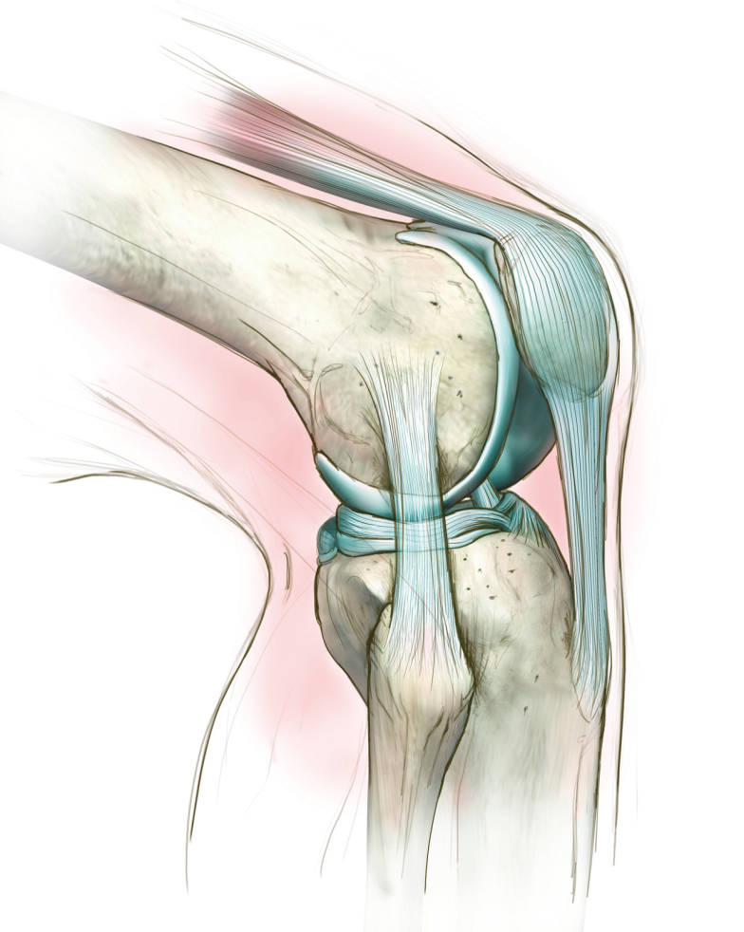
Notes:
Ok we will begin this session with a quick review… I would like you to shout out what are the different parts of a normal joint?

Slide 5
What do you do when your patients present with joint pain in the consultation?
Notes:
Ok, so you all see people in your clinics many of whom will have joint pain. What do you usually do when a patient presents with joint pain? Do you assess the joint in any way?

Slide 6
General approach
1. Look at the joint(s)
2. Feel the joint(s)
3. Move the joint(s)
4. Assess the function of the joint(s)
Notes:
Whilst you are not expected to be the ones diagnosing and carrying out complex joint assessment. Being able to look at an OA joint, recognise key features and get an initial understanding of how the joint moves can be really helpful and is also an important part of being confident around OA.
Assessments can cover 4 aspects…
After getting consent to have a look at the joint…we recommend initially getting a visual inspection of the joint…but you can also gain a lot of information by just watching how your patient walks in…
It is helpful to be comfortable feeling a joint…and touch can be an important therapeutic component, seeing how it moves and possibly assessing certain key functions…like sit to stand, walking or gripping for example.

Slide 7
What would we expect to see with an OA joint?
Notes:
Ok so what might we expect to see with an OA joint in the consultation room?
Enlarged joints, osteophytes, muscle wasting, joint malalignment/ deformity, etc…

Slide 8
Look
Start with a visual inspection of the joint at rest
make the person comfortable
do you need to see the joint?
starting position
hands?
hips?
knees?
feet?

Slide 9
Look
Compare sides
looking for symmetry
look for skin changes
muscle wasting
swelling in and around the joint
deformity and posture of the joint

Slide 10
What can you see here?
Notes:
Muscle wasting is common with people with arthritis and can be a result of pain and swelling inhibiting muscle use, and reductions in activity that lead to subsequent wasting.

Slide 11
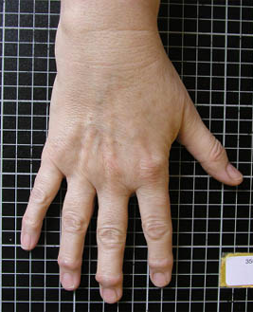
What can you see?
Notes:
So here we can see swelling around the distal joints of the fingers. This is a common sign of hand OA. Do we expect these swellings to be soft or hard? Does anyone know any other types of arthritis that can affect the hands?....yes in RA it is the knuckle joints (MCP) that are more commonly affected and enlarged.

Slide 12
Feel
Skin temperature with the back of your hand across the joint line
warmth is a feature of inflammation
Swelling
hard bony swelling NOT soft, boggy swelling
Tenderness at a joint line
Notes:
How confident do you feel touching an OA joint?...read slides…
Although traditionally not considered an inflammatory disease it is accepted that there are some inflammatory elements to OA.
Therapeutic touch during assessment can be important and joint line pain is often a sign of OA.
If you had a warm or exquisitely tender big toe joint what other conditions might you consider Gout/ inflamm arthropathy etc

Slide 13
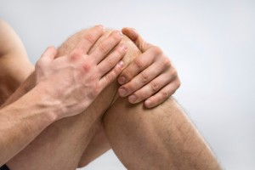
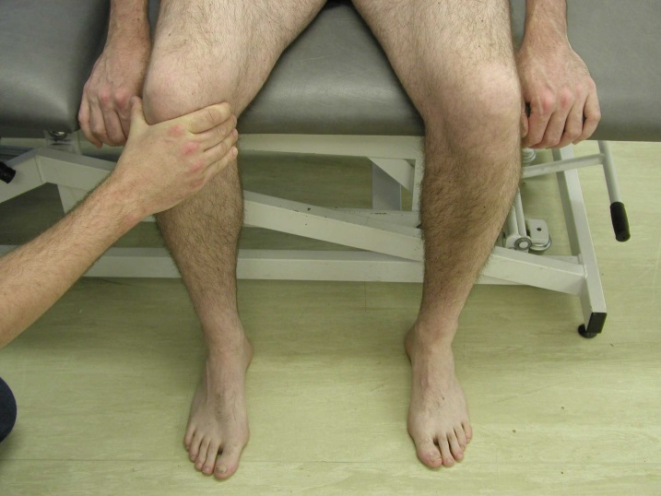
Clicking and creaking
Notes:
Many people with OA may experience clicking and creaking with their arthritic joints. This is quite normal and it is helpful not to overemphasise the relevance of this to patients…it is usually not associated with pain. Sounds can be made by little air pockets in the joint or by ligaments passing over bony prominences.

Slide 14
Move
Assess full range of movement of the joint
Compare both sides
Active movement should be performed by the patient with assistance if needed
the loss of active movement suggests a problem with the muscles, tendons or nerves, joints, or it may be an effect of pain in the joints
Notes:
Ask the patient to move the joint through a range of movement and compare both sides…how might we expect a OA joint to move?
Think about what might be the best position to move a patient in the available time…show examples…eg standing hip holding a chair/ knee in sitting/ hand resting on a table/pillow/arm rest.

Slide 15
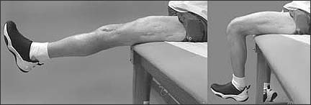
Loss of range of movement
Notes:
Stiffness and loss of movement is common in OA.
Compare to other side.
With the knee lack of extension can be as much/more of a problem than lack of flexion
Hand – grip

Slide 16
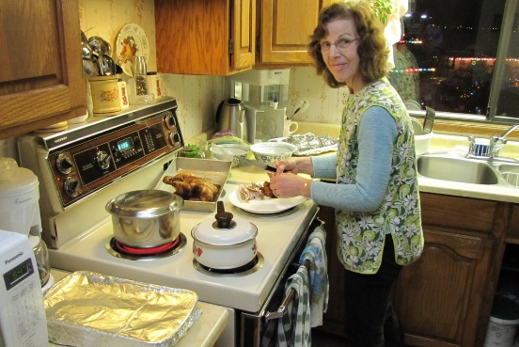
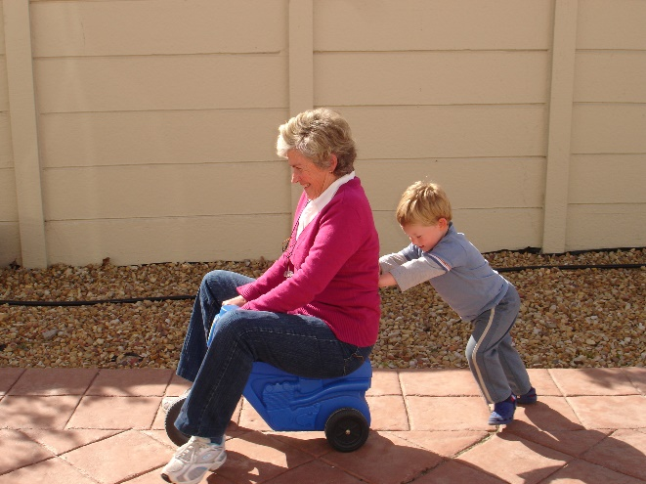
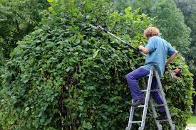
Functioning
Notes:
This should be tailored to the individual based on the assessment. Function means something different to everyone – basic daily function to more high level activity
If the patient struggled with getting up from chairs or walking you might want to look at his walking / sit to stand etc.
Fauja Singh oldest marathon runner 101 from East London – final race 10km in 1 hour 32 took up running in his 80s
Gardening – ask what it involves for them
Important for goal setting – relevant, engages patient as meaningful to them

Slide 17
Record
State which joint
State right or left
General comments
red flags
actions
Notes:
Following your assessment it is important to document your findings…this should include stating which joint you are looking at, the side of the body…any general comments and also any red flags or actions you have carried out.

Slide 18
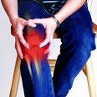
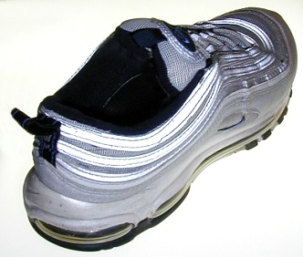
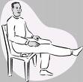
The role of exercise & physical activity for self-management of OA Laura Swaithes
Notes:
In this next session we will talk about the role of exercise and physical activity as part of condition self-management for people with OA…

Slide 19
NICE Core Treatments for OA
Core management
Education to support self-management (written and verbal)
Offer advice on the following core treatments to all people with clinical OA:
Exercise
(aerobic and muscle strengthening)
Weight loss
(if overweight/obese)
NICE Clinical Guideline CG177 Osteoarthritis: Care and management (2014) https://www.nice.org.uk/guidance/cg177

Slide 20
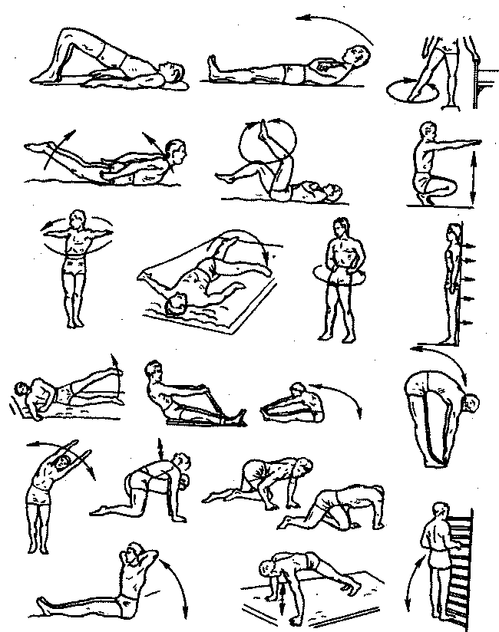
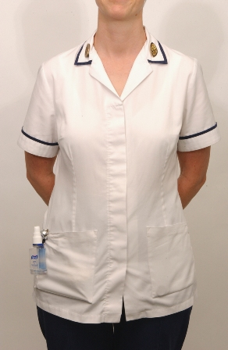
What is the role of the practice nurse in advising on exercise and physical activity for OA?
Notes:
So what do you think is the role of the practice nurse in advising about exercise and OA?
…educate re benefits/ give information advise and signpost/ support with goal setting…

Slide 21
Exercise for OA: the evidence
Many national and international guidelines are available for the management of OA and all recommend exercise
“Exercise should be a core treatment for people with osteoarthritis, irrespective of age, co-morbidity, pain severity or disability”
NICE 2014
Notes:
So we know …read

Slide 22
What are the barriers to exercise?
Don’t believe exercise will help them
Fear of falling/pain/ damaging joints further (safety)
Lack of enjoyment
No quick results
Weather
Time
Conflicting advice
Do as I say not as I do?
Notes:
Hendry et al 2006, Holden et al 2012, Dobson 2016 also capability and low Self efficacy beliefs

Slide 23
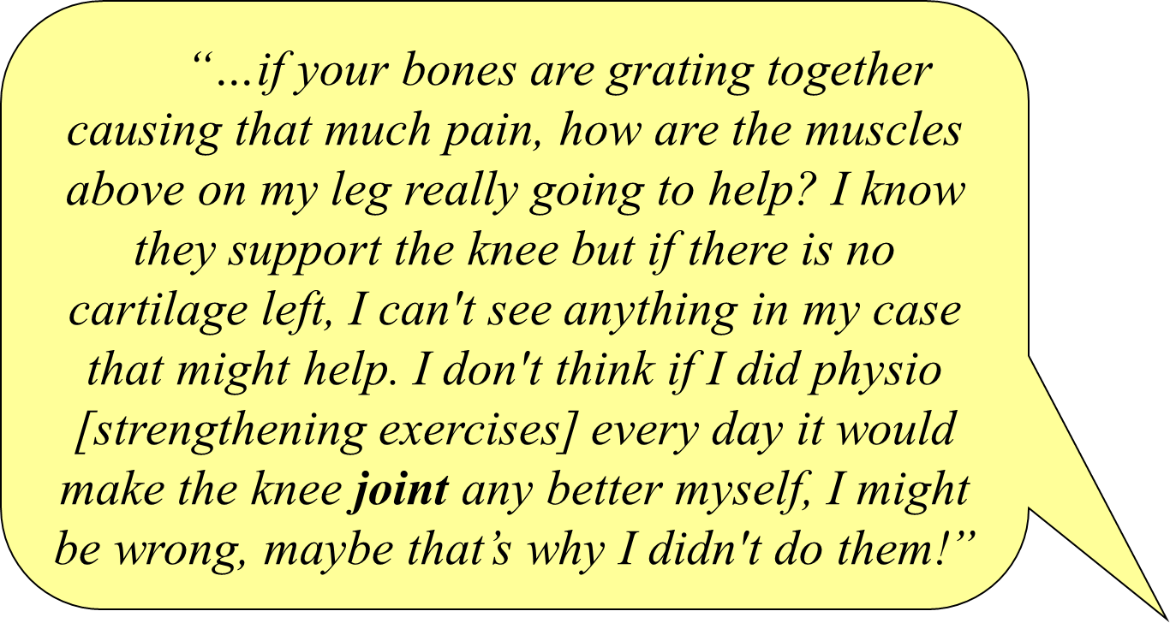
Don’t believe exercise will help?
Notes:
Read…
A key barrier is that for some people they don’t believe exercise can help…I will read you this interview quaotation…

Slide 24
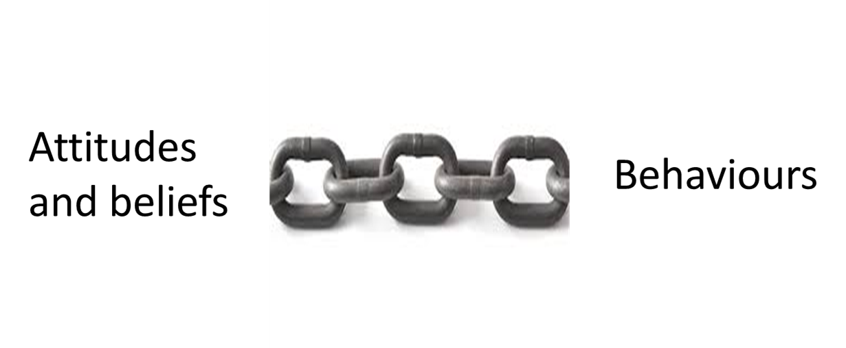
“Outcome expectations of exercise and confidence in ones ability to exercise are linked to how physically active people with knee OA are”
Quicke et al 2016
Notes:
So we know there is a link between peoples attitudes and beliefs and what they do…
Research I have carried out on people with knee OA has shown if people believe that they will benefit from exercise and are more confident about their ability to exercise with OA that they are more likely to carry out higher levels of physical activity.
Hendry et al 2006, Holden et al 2009, Quicke et al 2016

Slide 25
Will exercise and activity worsen OA and is it safe?
Notes:
Another important barrier to exercising and keeping active with OA is that some people believe it may make their OA worse and not be safe…

Slide 26
“It seems common sense that if you’ve got a deterioration in the joint like which arthritis is, or, the things in-between the joint, then, the more you do it, the more it’s going to be worn. I wouldn’t have thought it’s something that would get better with practice, you know, with exercise, I wouldn’t have thought that would improve it. If something’s broke in there, then waggling it about can’t do it a lot of good, I wouldn’t have thought.”

Slide 27
Is exercise safe for patients with OA?
“There are few contraindications to the prescription of strengthening or aerobic exercise in patients with hip or knee OA” Roddy et al 2005
“No evidence of serious adverse events, increases in pain, decreases in physical function, progression of structural OA on imaging or increased TKR at group level with therapeutic exercise” Quicke et al 2015
Notes:
Consensus from a group of OA expert clinicians and academics highlighted that…
Whilst a recent systematic review carried out investigating the safety of long term therapeutic exercise revealed…no evidence of serious side effects resulting in death or permanent disability. Long-term exercise did not increase pain at a group level or lead to progression of structural OA compared to non exercise groups.
Accidents such as falls were very rare and a minority of participants reported mild or temporary increases in pain.
No direct evidence concerning specific contraindications to exercise for hip or knee OA

Slide 28
Benefits of exercise and activity for OA
Physical benefits
Improved balance
Improved strength
Increased walking speed
Reduced stiffness
Cognitive benefits
Improved mood
Greater self-efficacy
Advantages:
Cheap
Simple
Few side effects
Benefits multiple health conditions
Other benefits
Reduced pain and use of NSAIDs
Reduced GP consultations
Notes:
So what do you think might be the benefits of exercise and physical activity for people with OA?

Slide 29
Prescribing exercise in the presence of pain
Physical activity
Deconditioning
Osteoarthritis
Joint pain
Reduced activity
A familiar vicious circle?

Slide 30
Prescribing exercise in the presence of pain
Physical activity
Deconditioning
COPD
Breathlessness
Reduced activity

Slide 31
Prescribing exercise in the presence of pain
Physical activity
Deconditioning
Fatigue
Tiredness
Reduced activity

Slide 32
Prescribing exercise in the presence of pain
Physical activity
Deconditioning
Osteoarthritis
Joint pain
Reduced activity
We need to act here

Slide 33
Prescribing exercise in the presence of pain
Offer advice and reassurance
(hurt does not equal harm)
Pharmacological options
Non-pharmacological options
- Heat/ ice
- Footwear
- TENS
Focus on pacing
Notes:
So what tools can we use to help exercise adherence when prescribing exercise in the presence of pain?

Slide 34
Prescribing exercise in the presence of pain: focus on pacing
“Boom”
Activity
level
“Bust”
Time

Slide 35
Prescribing exercise in the presence of pain: focus on pacing
Activity
level
Time

Slide 36
Summary recap
Exercise and regular physical activity is recommended for everyone with OA
Exercise has many associated benefits for people with OA
We can influence and address many barriers to exercise and regular physical activity such as unhelpful beliefs about exercising

Slide 37
Practical session
Advising local joint exercises
Laura Swaithes

Slide 38
Simulation: The initial exercise programme
Select appropriate joint exercises for the patient
Give the patient these exercises
a. ‘Sell’ the exercises
b. Demonstrate and ‘do’
c. Supervise the exercises
c. Offer advice about pain
d. Let the patient know what to expect
3. Set a goal

Slide 39
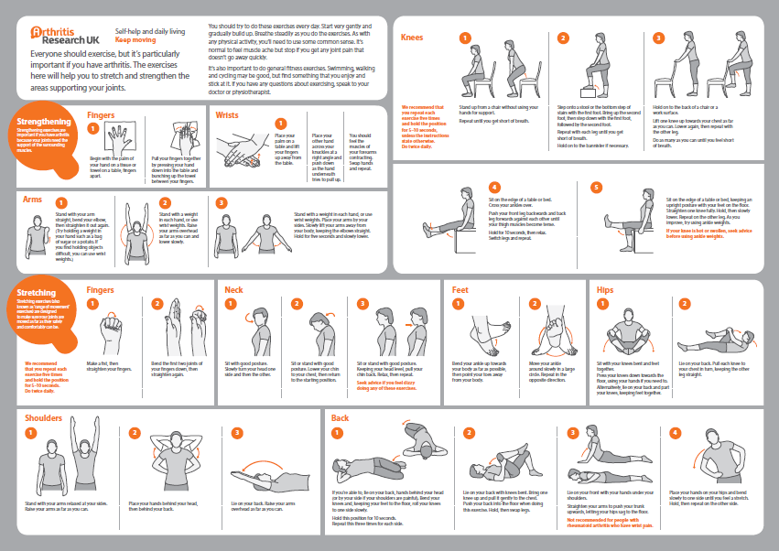

Slide 40
Plan for implementation in your practice
How prepared do you feel to support OA self-management for your patients?
How might you organise your consultations (eg clinic, during LTC sessions, etc)
How can we engage and train the GPs?
Would you be interested in being a nurse champion?
A local practice nurse network around OA?

Slide 41
OA pain management Lizzie Cottrell
Notes:
We going to briefly discuss pain relief for patients with OA
Are any of you prescribers?

Slide 42
What advice do you give to patients about pain management?
Notes:
Flipchart

Slide 43
Managing OA
Core management
Adjunct to core management
Not recommended
1st line
2nd line
Education to support self-management (written and verbal)
Paracetamol
Oral NSAIDs
Glucosamine or chondroitin
Topical NSAID
COX-2 inhibitors
Local heat or cold
Opioids
Acupuncture
Exercise
(aerobic and muscle strengthening)
Topical capsaicin
Tricyclic agents
Assistive devices
Rubefacients
Supports/braces
IA hyaluronan inject
Weight loss
(if overweight/obese)
Arthroscopic lavage/debridement (unless clear mechanical locking)
TENS
Manipulation/Stretching (hip)
Advice on appropriate footwear
(Lower limb OA - inc shock-absorbing properties)
Intra-articular corticosteroid injections
Joint arthroplasty
Follow-up for all patients with symptomatic OA
NICE Clinical Guideline CG177 Osteoarthritis: Care and management (2014) https://www.nice.org.uk/guidance/cg177

Slide 44
OA treatments recommended by NICE
Effectiveness:
under review
Safety:
under review
Adjunct to core management
1st line
Paracetamol
Topical NSAID
Knee and hand
Caution: irritant
Local heat or cold
Topical capsaicin
Assistive devices
Supports/braces
Effectiveness:
topical = oral (knee/hand)
Safety:
topical > oral
TENS
Manipulation/Stretching (hip)
Intra-articular corticosteroid injections
Joint arthroplasty
NICE Clinical Guideline CG177 Osteoarthritis: Care and management (2014) https://www.nice.org.uk/guidance/cg177

Slide 45
OA treatments recommended by NICE
KEY CLINICAL MESSAGES
Capsaicin
Burns upon application
Pain receptors
“TRVP1”
Frequent application needed
BNF Feb 2018
Pain receptors
“TRVP1”
Pain receptors
“TRVP1”

Slide 46
OA treatments recommended by NICE
Adjunct to core management
2nd line
PPI
Oral NSAIDs
Safety: consider risk factors
COX-2 inhibitors
Opioids
Safety: risks with short and long term use
NICE Clinical Guideline CG177 Osteoarthritis: Care and management (2014) https://www.nice.org.uk/guidance/cg177

Slide 47
EMIS Web Templates Lizzie Cottrell

Slide 48
Template started
Template triggered by Read Codes developed and tested in MOSAICS (Managing Osteoarthritis in Consultations Study) for implementing core NICE recommendations

Slide 49
Option to use or exit template
Use of template recorded for audit
NICE Statement 1 Adults aged 45 or over are diagnosed with OA clinically without investigations if they have activity‑related joint pain and any morning joint stiffness lasts no longer than 30 minutes.

Slide 50
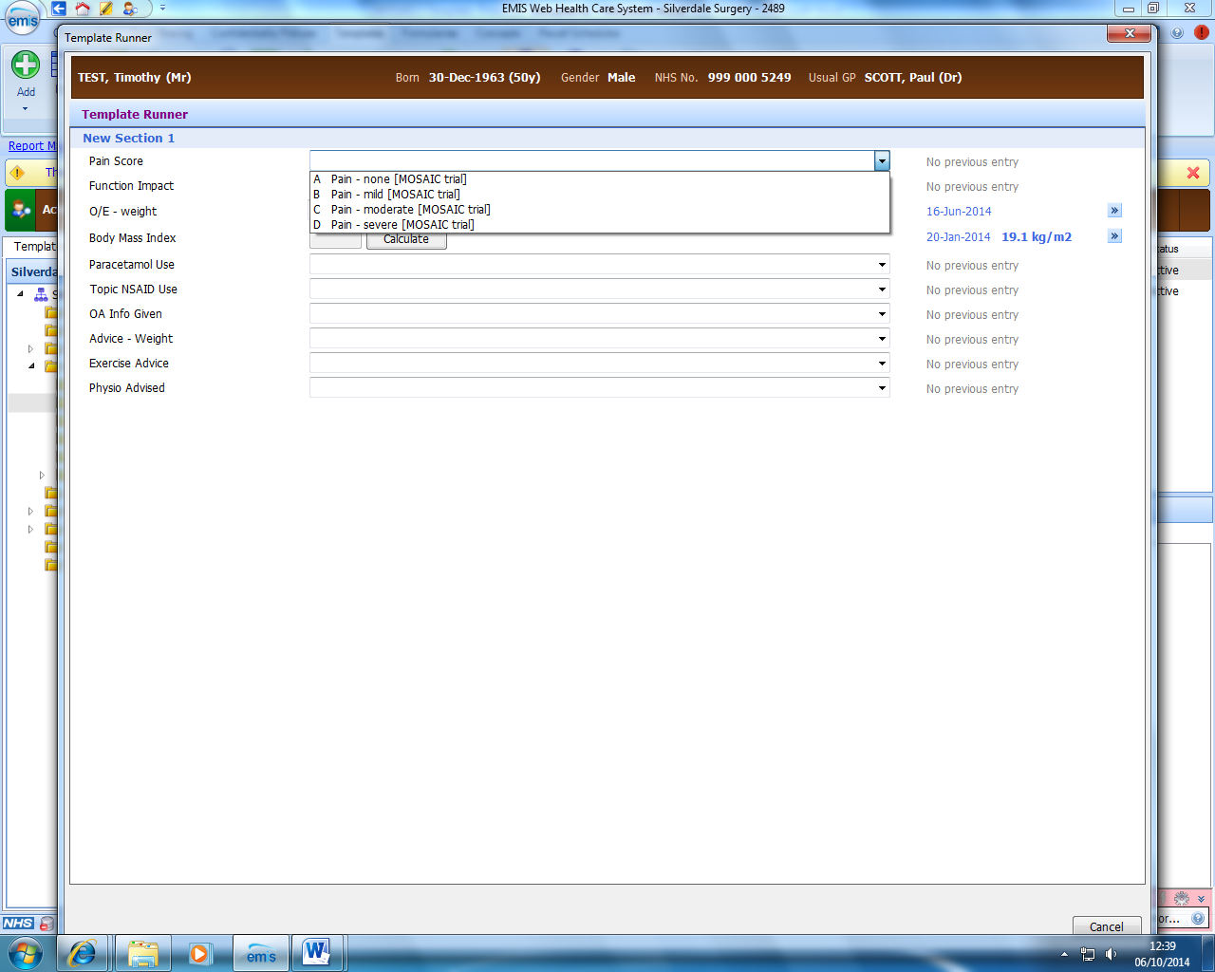
Menu for pain assessment
NICE Quality Standard includes assessment of joint pain
NICE Statement 2 Adults newly diagnosed with OA have an assessment that includes pain, impact on daily activities and quality of life.
Ask patient to choose current reported level of pain
Note: “MOSAIC trial” is label that indicates which Read Code is being used – we had to get extra codes for this

Slide 51
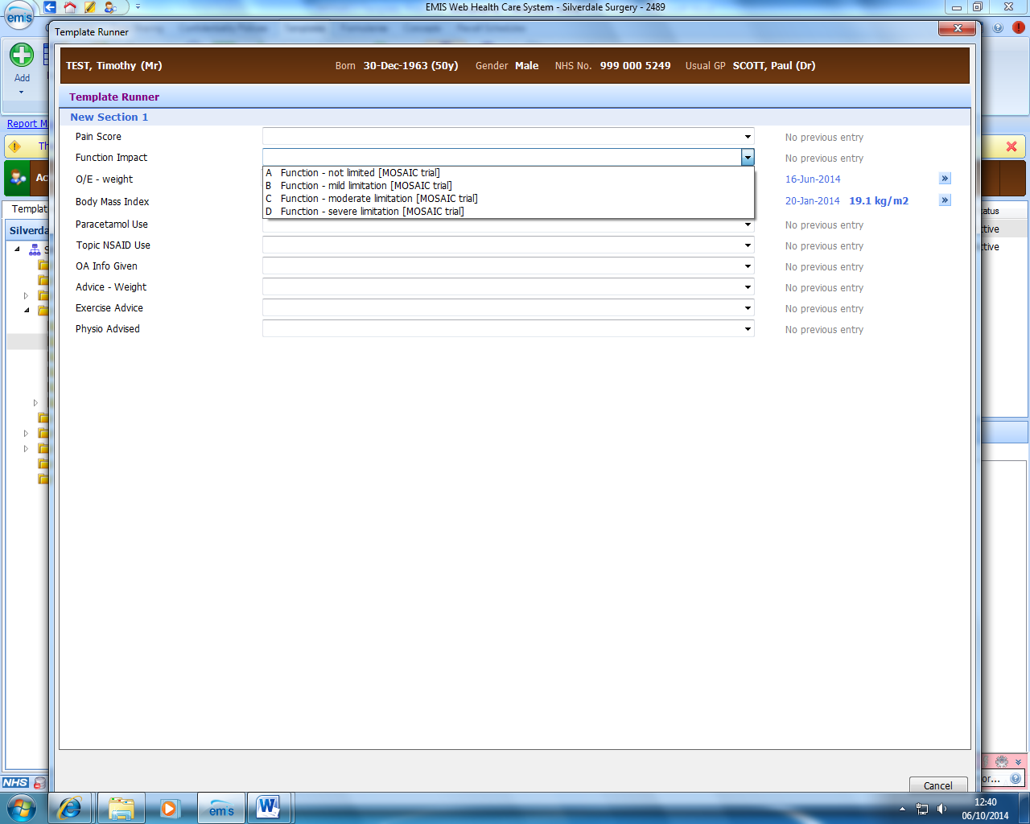
Menu for level of functional impairment
NICE Quality Standard includes impact on daily activities and quality of life
NICE Statement 2 Adults newly diagnosed with OA have an assessment that includes pain, impact on daily activities and quality of life.
Ask patient to select option in relation to current limitation of normal activities due to joint symptoms

Slide 52
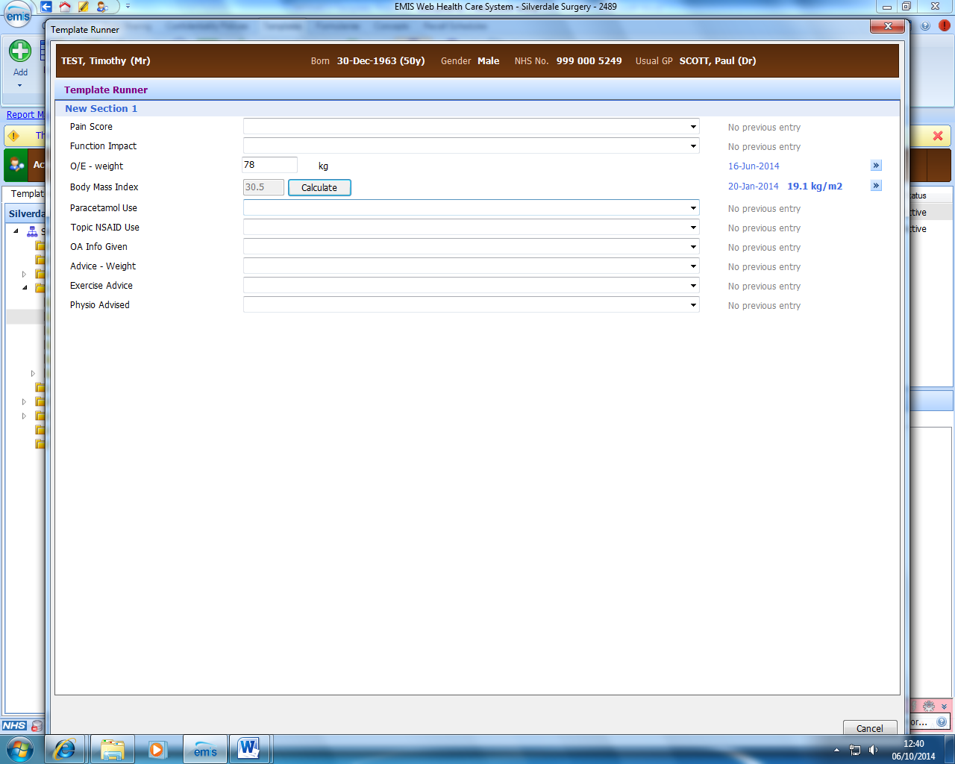
Current weight/BMI
NICE Statement Adults with osteoarthritis who are overweight or obese are offered support to lose weight

Slide 53
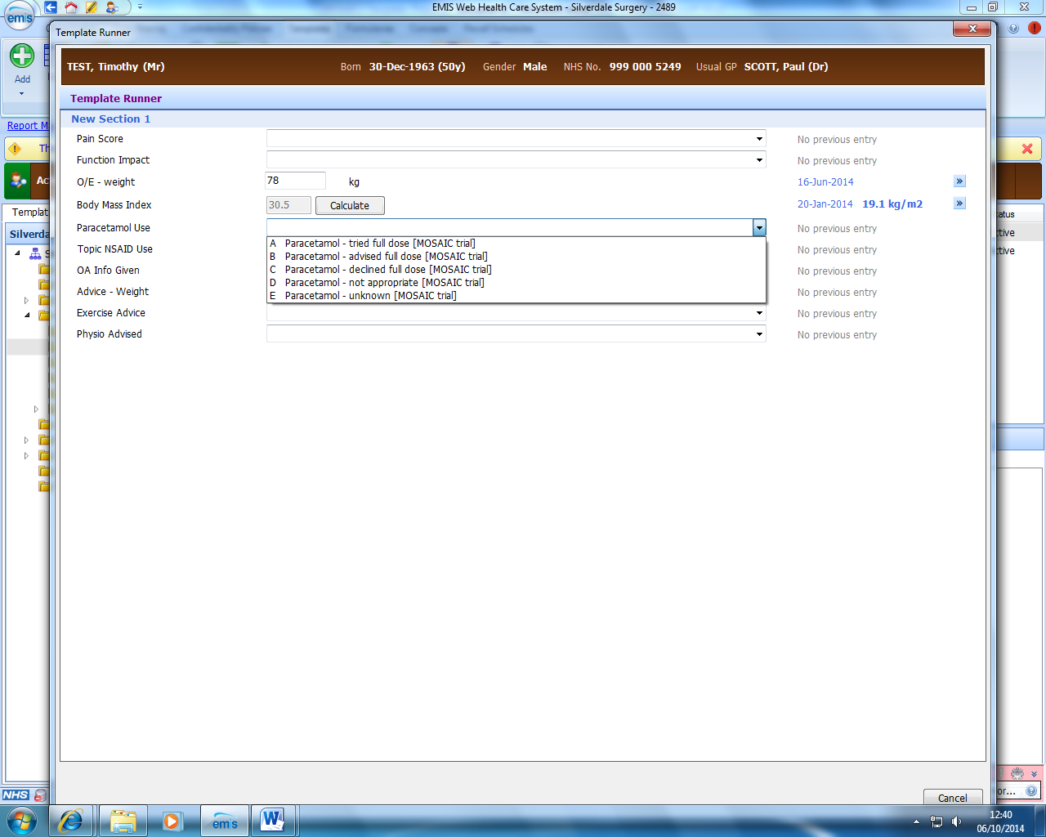
Paracetamol analgesia
Paracetamol is one of the core treatments recommended by NICE for OA in the 2008 Guidance
Consider its use in light of newer evidence on efficacy and safety
Full dose implies 1G paracetamol 4 times a day, timed to manage pain effectively

Slide 54
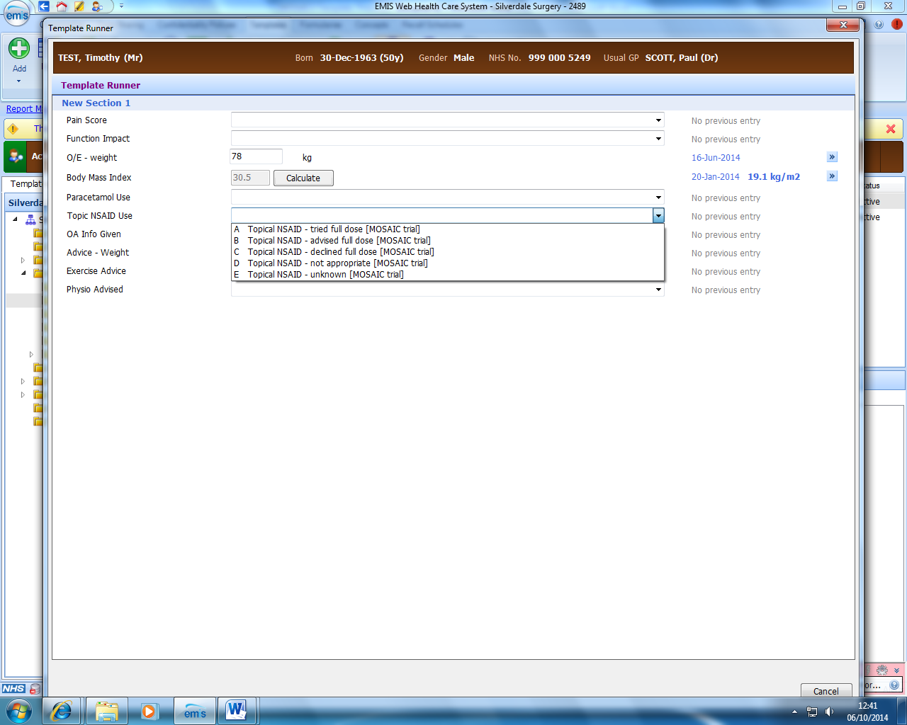
Topical NSAID
Topical NSAIDS are first line pharmacological treatment options for OA recommended by NICE

Slide 55
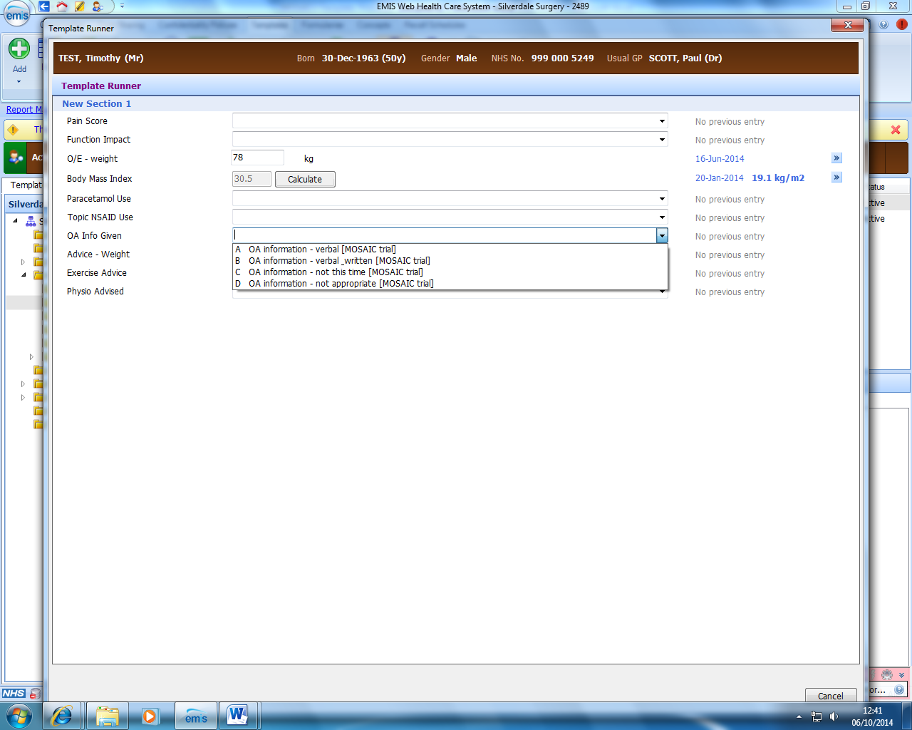
Patient information
NICE Quality Standards include a supported shared management plan with patients and support with core treatments for 3 months before any specialist referral
NICE Statement 3 Adults with OA participate in developing a self‑management plan that directs them to any support they may need.
Written information includes the Keele “Guide for people who have osteoarthritis” and Arthritis Research UK booklets on exercises

Slide 56
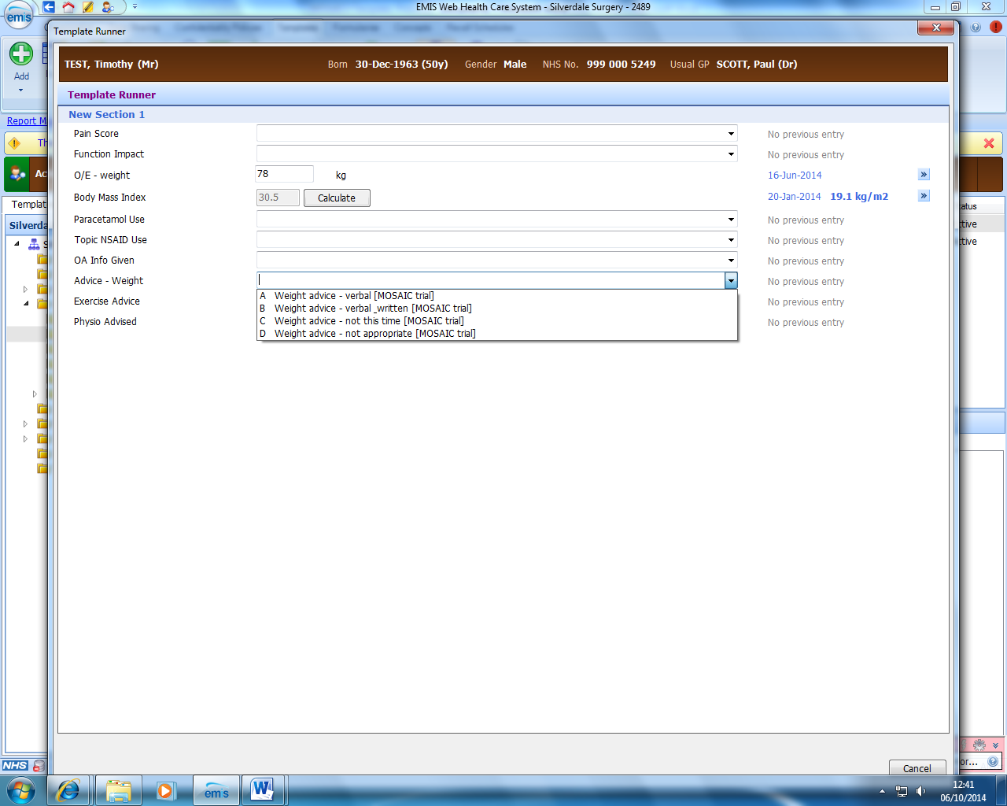
Advice on weight
NICE Quality Standard includes offering support for patients who are overweight or obese to lose weight
NICE Statement 5 Adults with OA who are overweight or obese are offered support to lose weight.
Written advice might include specific information on local services to assist patients with weight loss

Slide 57
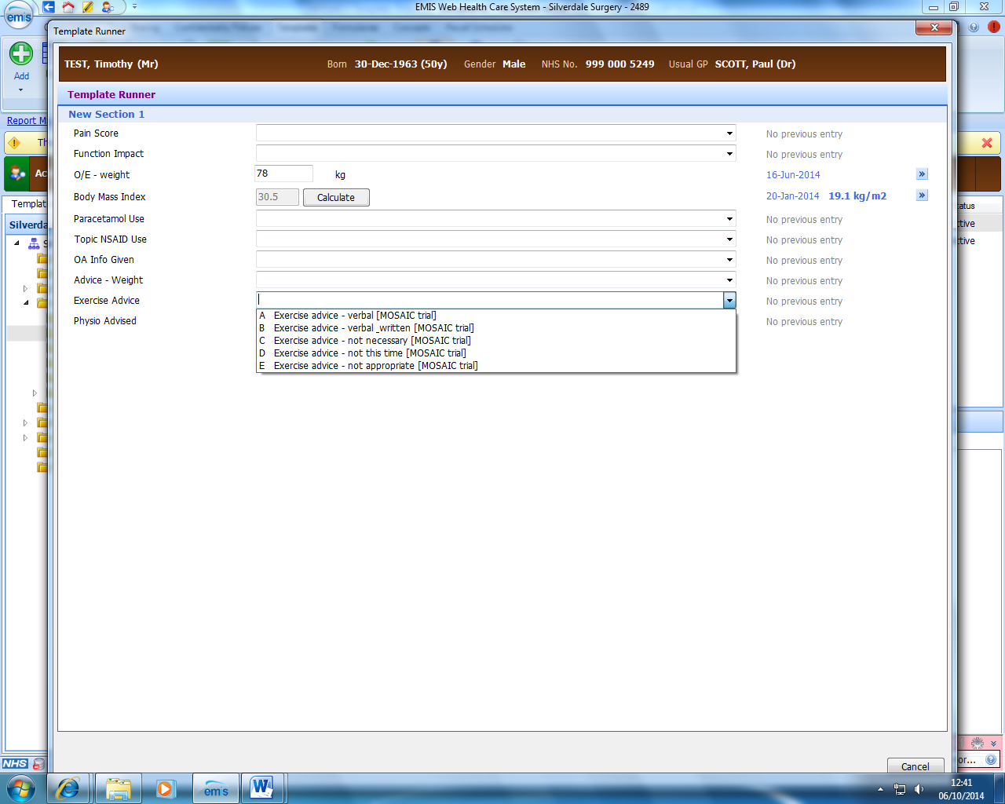
Advice on exercise
NICE Quality Standards include advising patients to participate in muscle strengthening and aerobic exercise
NICE Statement 4 Adults with OA are advised to participate in muscle strengthening and aerobic exercise.
Written advice might include the guide and booklets mentioned; also pointers to videos, local activity programmes, etc

Slide 58
Physiotherapy referral
If appropriate, this would be to supplement advice and support given at practice level.
NICE Statement 4 Adults with OA are advised to participate in muscle strengthening and aerobic exercise.
NICE guidance does not specify which professional or non-professional provides exercise advice and support
Local circumstances will determine appropriateness
Physio may be the access route for aids, if needed

Slide 59
Template completed
Reminder:
NICE Statement 8 Healthcare professionals do not use scoring tools to identify which adults with OA are eligible for referral for consideration of joint surgery

Slide 60
Data saved

Slide 61
Completed record
All template entries can be reported in audit

Slide 62
Review of last weeks consultation plan

Slide 63
Putting it into practice Andrew Finney

Slide 64
What are Simulated Patients?
Lay people, not health professionals
Trained and experienced in:
Presenting a role consistently
Responding intuitively as an ordinary patient
Giving feedback whilst in role

Slide 65
The task and your role
You are consulting for real – not a role play
Group plan for the consultation
One person starts the consultation
Consultation proceeds in series of chunks
Opportunities to review, change plan, try again, take turns
You are not being judged as an individual – it is a group task and responsibility

Slide 66
Tools and techniques
One or two facilitators organising and helping
Use pen and paper to aid memory
Start/pause/resume/rewind
SP will withdraw during pauses
Analyse, comment, generate ideas in pauses
Check doubts with feedback questions of SP but no “what if” questions

Slide 67
Key points
Relax and enjoy the experience
Don’t worry about getting it wrong – that’s the only way to learn
Simulators are robust – you can’t harm them
There are lots of different styles and ways of achieving outcomes – learn from each other and try new ideas

Slide 68
How are you going to take this forward?

Slide 69
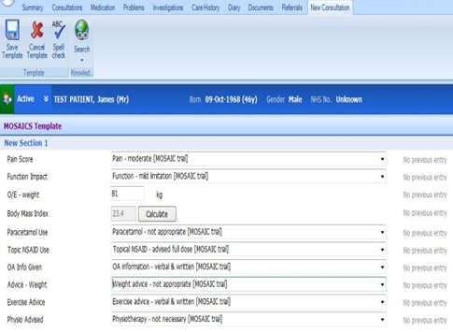
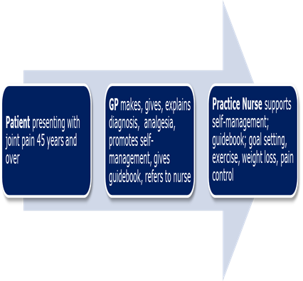
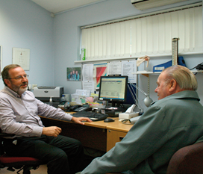
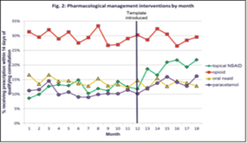
JIGSAW-E Joint Implementation of Guidelines for Osteoarthritis in Western Europe
JIGSAW-E will support primary care in six European countries to address the unmet needs of adults consulting for OA.
This will be achieved through the systematic implementation of previously piloted innovations in JIGSAW in the West Midlands, UK.
Notes:
KDz

Slide 70
THANK YOU, and WELL DONE PLEASE FILL OUT YOUR EVALUATION FORMS

