Slide 1
Enhancing Primary Care Management of OA
GPN Workshop Day 1
Andrew Finney, Vince Cooper and Lizzie Cottrell

Slide 2
Introductions
Andrew Finney
Notes:
Andrew, Vince, Lizzie and Nicki to introduce ourselves. Nicki to follow her introduction with brief overview of why GPNs are here today, JIGSAW, what CCGs have agreed and what practices have signed up to etc
General introductions and the participants are asked to tell the group their role and experience of managing long term conditions

Slide 3
What does Joint pain mean for someone you know?
Andrew Finney
Notes:
Participants are asked to think about a patient, friend or relative, and in pairs to describe them, their lives and how OA affects them and those around them. Pairs asked to feedback to group on what OA meant for the people they discussed.
Prompts for impact
OA impact very variable – for some little impact but can be severe and ongoing
Impaired bodily functions or structure
Pain
Stiffness / gelling
Reduced joint movement
Joint weakness
Nodes / bony enlargement
Crepitus
OA changes on x-ray
Activity limitation
Reduced mobility / weaken hand grip
Problems with ADLs – dressing / washing / cooking / standing / walking / shopping / gardening / swimming / hobbies and recreational activities / sleeping
Participation restriction
Reduced work / social life - sickness absence / ill health retirement / unable to join in with friends and family (walks / outings / sports / etc)
Coping with OA
Altered way of living / working
Self-care – medication / exercise / weight
OA treatment
Joint replacement
Co-morbidities
Anxiety and depression
Affect on other LTCs – pain restricts walking to help with diabetes / COPD / coronary heart disease

Slide 4
How does OA present?
Andrew Finney
Notes:
Flip Chart exercise
Presenting problem – predominantly pain but can be functional problems – need to ask
Sites – knee / hip / hand / foot – often has affected several sites but not a symmetrical presentation at the same site as in RA
Back and neck pain is not managed as OA, but as back/neck pain, and so not an OA site
Pain normally worse after activity
Gelling after rest but not significant morning stiffness
Duration – months and often years / flares come and go
Not v acute as in gout or RA
Examination – bony enlargement / nodes / crepitus / malalignment / often no signs / absence of red-flag signs – heat / large effusion / synovitis

Slide 5
What is OA?
Vince Cooper

Slide 6
WHAT IS OSTEOARTHRITIS?
What are your concepts?
Notes:
Presenting problem – predominantly pain but can be functional problems – need to ask
Sites – knee / hip / hand / foot – often has affected several sites but not a symmetrical presentation at the same site as in RA
Pain after activity
Gelling after rest but not significant morning stiffness
Duration – months and often years / flares come and go
Not v acute as in gout or RA

Slide 7
Consider other long-term conditions
(e.g. T2 Diabetes, COPD)
What are the causes?
What is their natural history?
How do you explain them to patients?
What are the goals in managing them?
What are the criteria for success?

Slide 8
How does this fit with OA?
What are the causes?
What structures are involved?
What is its natural history?
How do you explain it to patients?
What are the goals in managing OA?
What are the criteria for success?

Slide 9
The underlying problem
Wear and repair processes in joints
Possible X-ray changes
Symptoms
Notes:
To illustrate that OA can be defined radiographically or clinically – both the result of the underlying pathology.

Slide 10

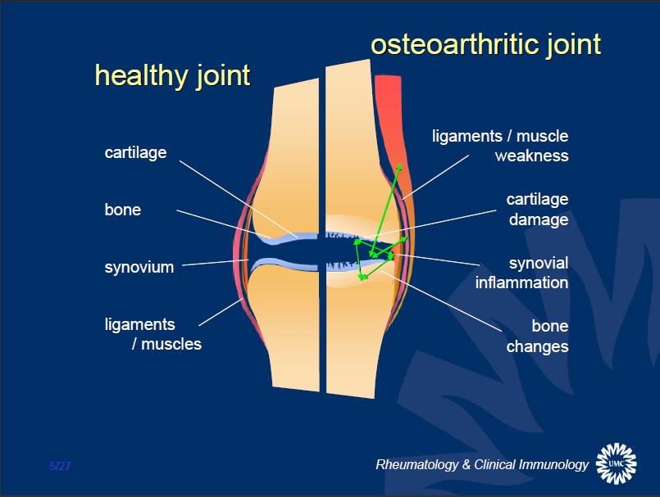
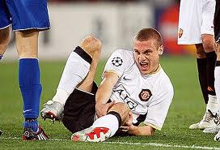
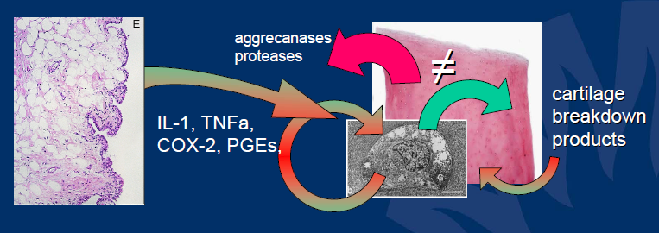
The underlying problem - complex
© Floris Lafeber
Notes:
All joint tissues affected – cartilage / bone / synovium / ligaments and muscles
Pathology in all tissues – go through examples illustrated
Predominately driven by excess loading of the joint, for example through weight or injury
Joint is metabolically active – repair processes responding to stresses

Slide 11
The concept of osteoarthritis – a shift in understanding
Biomedical
Biopsychosocial
Simplistic mechanical “cartilage degeneration” and/or “bone-on-bone” descriptions
Symptom-based, chronic pain model
Symptoms are:
Variable
Often not progressive
Psychological and social components are important

Slide 12
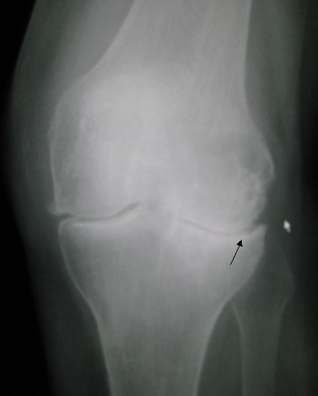
How to define - Symptoms or X-rays?
Pain and function matter to patients
X-ray imaging does not add much:
  Most older people with joint pain have x-ray changes of OA even without any symptoms
  Amount of pain not fully explained by degree of x-ray changes
MRI is unhelpful except in trauma
Notes:
The argument for defining clinically

Slide 13
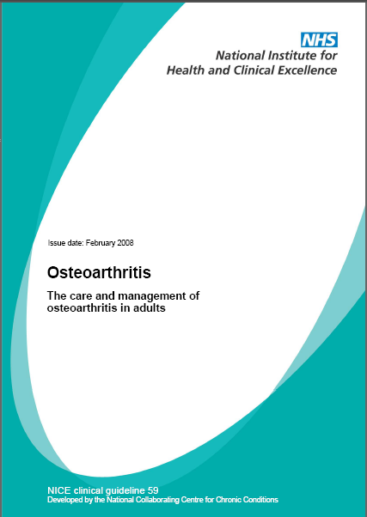
A working diagnosis of OA
  Persistent joint pain with use (knee, hip, hand)
  Age 45 years and over
  Morning stiffness less than ½ hour
  An alternative diagnosis is unlikely
Notes:
NICE’s definition of a working diagnosis of OA

Slide 14

Sites commonly affected by osteoarthritis
Ends of fingers
Neck
Base of thumb
Lower back
Hips
Knees
Base of big toe
Arthritis Research UK: https://www.arthritisresearchuk.org/arthritis-information/conditions/osteoarthritis/which-joints-are-affected.aspx

Slide 15
Making the diagnosis
Understanding the problem
  The patient’s story
  Pain / mobility / activities (work & social)
  Ideas, concerns and expectations (ICE)
  What they have tried already
Clinical working diagnosis
  Typical OA history (examination)
  Alternative diagnosis unlikely
Notes:
An overview of taking the history and making a working diagnosis of OA

Slide 16
Indicators of “alternative or additional diagnoses”
Fracture
History of trauma
Rapid worsening of symptoms
Gout
Other inflammatory arthritides (e.g. RA, PMR)
Prolonged morning joint-related stiffness
Hot swollen joint
Septic arthritis
Numbness
Malignancy
Systemic upset
Radicular or neuropathic pain

Slide 17
The natural history of knee OA (in 600 people)
Not progressive for everyone (but flares are common)
Mild,
non-progressive
N = 208
Progressive
N = 170
Moderate
N = 137
Improving
N = 65
Severe,
non-improving
N = 20
WOMAC pain (0-20)
Time (in years) since baseline
Nicholls Osteoarthritis Cartilage 2014
Notes:
Figure shows the knee pain trajectories of 600 people aged 50 and over with knee pain who responded to a community survey. WOMAC pain is a measurement of pain on activity which sums the scores from five questions: no pain (0) to severe pain (4). Further details in abstract below. Similar pattern is seen in hip OA other than for hip OA there is a rapidly progressive group.
Slide to illustrate that OA is not inevitably progressive, and in some pain improves over time, but for some there is severe ongoing pain.
Nicholls E, Thomas E, van der Windt DA, Croft PR, Peat G. Pain trajectory groups in persons with, or at high risk of, knee osteoarthritis: findings from the Knee Clinical Assessment Study and the Osteoarthritis Initiative. Osteoarthritis Cartilage. 2014 Dec;22(12):2041-50. doi:10.1016/j.joca.2014.09.026.
OBJECTIVE:
The authors aimed to characterize distinct trajectories of knee pain in adults who had, or were at high risk of, knee osteoarthritis using data from two population-based cohorts.
METHOD:
Latent class growth analysis was applied to measures of knee pain severity on activity obtained at 18-month intervals for up to 6 years between 2002 and 2009 from symptomatic participants aged over 50 years in the Knee Clinical Assessment Study (CAS-K) in the United Kingdom. The optimum latent class growth model from CAS-K was then tested for reproducibility in a matched sample of participants from the Osteoarthritis Initiative (OAI) in the United States.
RESULTS:
A 5-class linear model produced interpretable trajectories in CAS-K with reasonable goodness of fit and which were labelled "Mild, non-progressive" (N = 201, 35%), "Progressive" (N = 162, 28%), "Moderate" (N = 124, 22%) "Improving" (N = 68, 12%), and "Severe, non-improving" (N = 15, 3%). We were able to reproduce "Mild, non-progressive", "Moderate", and "Severe, non-improving" classes in the matched sample of participants from the OAI, however, absence of a "Progressive" class and instability of the "Improving" classes in the OAI was observed.
CONCLUSIONS:
Our findings strengthen the grounds for moving beyond a simple stereotype of osteoarthritis as "slowly progressive". Mild, non-progressive or improving symptom trajectories, although difficult to reproduce, can nevertheless represent a genuinely favourable prognosis for a sizeable minority.
Copyright © 2014 The Authors. Published by Elsevier Ltd.. All rights reserved.

Slide 18
Natural history of OA
Not progressive for everyone (but flares are common)
Level of pain and disability can be significant for some
Joint replacement is not the eventual outcome for most patients
BUT joint replacement if needed has good outcomes for most
Notes:
Summary points re OA natural history

Slide 19
What are your management goals?
Flip-chart exercise

Slide 20
Managing Oa
Lizzie Cottrell

Slide 21
Managing OA
Core management
Adjunct to core management
Not recommended
1st line
2nd line
Education to support self-management (written and verbal)
Paracetamol
Oral NSAIDs
Glucosamine or chondroitin
Topical NSAID
COX-2 inhibitors
Local heat or cold
Opioids
Acupuncture
Exercise
(aerobic and muscle strengthening)
Topical capsaicin
Tricyclic agents
Assistive devices
Rubefacients
Supports/braces
IA hyaluronan inject
Weight loss
(if overweight/obese)
Arthroscopic lavage/debridement (unless clear mechanical locking)
TENS
Manipulation/Stretching (hip)
Advice on appropriate footwear
(Lower limb OA - inc shock-absorbing properties)
Intra-articular corticosteroid injections
Joint arthroplasty
Follow-up for all patients with symptomatic OA
NICE Clinical Guideline CG177 Osteoarthritis: Care and management (2014) https://www.nice.org.uk/guidance/cg177

Slide 22
NICE Core Treatments for OA
Core management
Education to support self-management (written and verbal)
Offer advice on the following core treatments to all people with clinical OA:
Exercise
(aerobic and muscle strengthening)
Weight loss
(if overweight/obese)
NICE Clinical Guideline CG177 Osteoarthritis: Care and management (2014) https://www.nice.org.uk/guidance/cg177

Slide 23

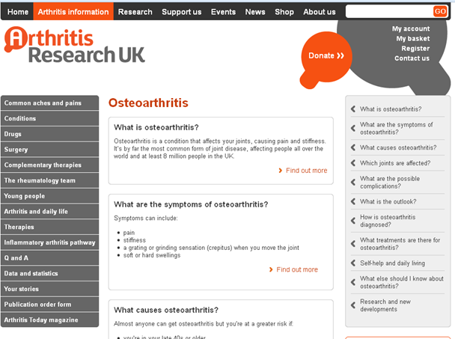
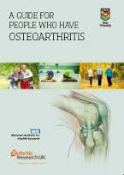



Providing quality information

Slide 24
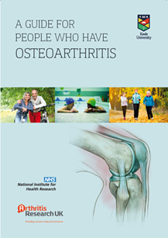
OA Guidebook
‘to actually give them that [core treatment] backed up with written information I really think that makes a difference to the impact’
(GP)
‘they’d read a little bit about what we were going to do prior to coming to see me so all I did was sort of reinforce the information so that was good’
(Practice Nurse)
Morden A, Jinks C, Ong BN, et al. BMC Musculoskelet Disord. 2014 Dec 13;15:427.

Slide 25
OA treatments recommended by NICE
Effectiveness:
under review
Safety:
under review
Adjunct to core management
1st line
Paracetamol
Topical NSAID
Knee and hand
Caution: irritant
Local heat or cold
Topical capsaicin
Assistive devices
Supports/braces
Effectiveness:
topical = oral (knee/hand)
Safety:
topical > oral
TENS
Manipulation/Stretching (hip)
Intra-articular corticosteroid injections
Joint arthroplasty
NICE Clinical Guideline CG177 Osteoarthritis: Care and management (2014) https://www.nice.org.uk/guidance/cg177

Slide 26
OA treatments recommended by NICE
Adjunct to core management
2nd line
PPI
Oral NSAIDs
Safety: consider risk factors
COX-2 inhibitors
Opioids
Safety: risks with short and long term use
NICE Clinical Guideline CG177 Osteoarthritis: Care and management (2014) https://www.nice.org.uk/guidance/cg177

Slide 27
Explaining Oa
Lizzie Cottrell

Slide 28
The importance of an explanation
Fundamental to improving patient outcomes
Affects how people think about their bodies, their pain and ultimately their behaviour
Effective explanation helps with management planning especially lifestyle changes

Slide 29
What is the target of an explanation?
Understand their condition and their future with it
Know it is possible to, and how they can, self-manage their OA
Believe recommended management will work

Slide 30
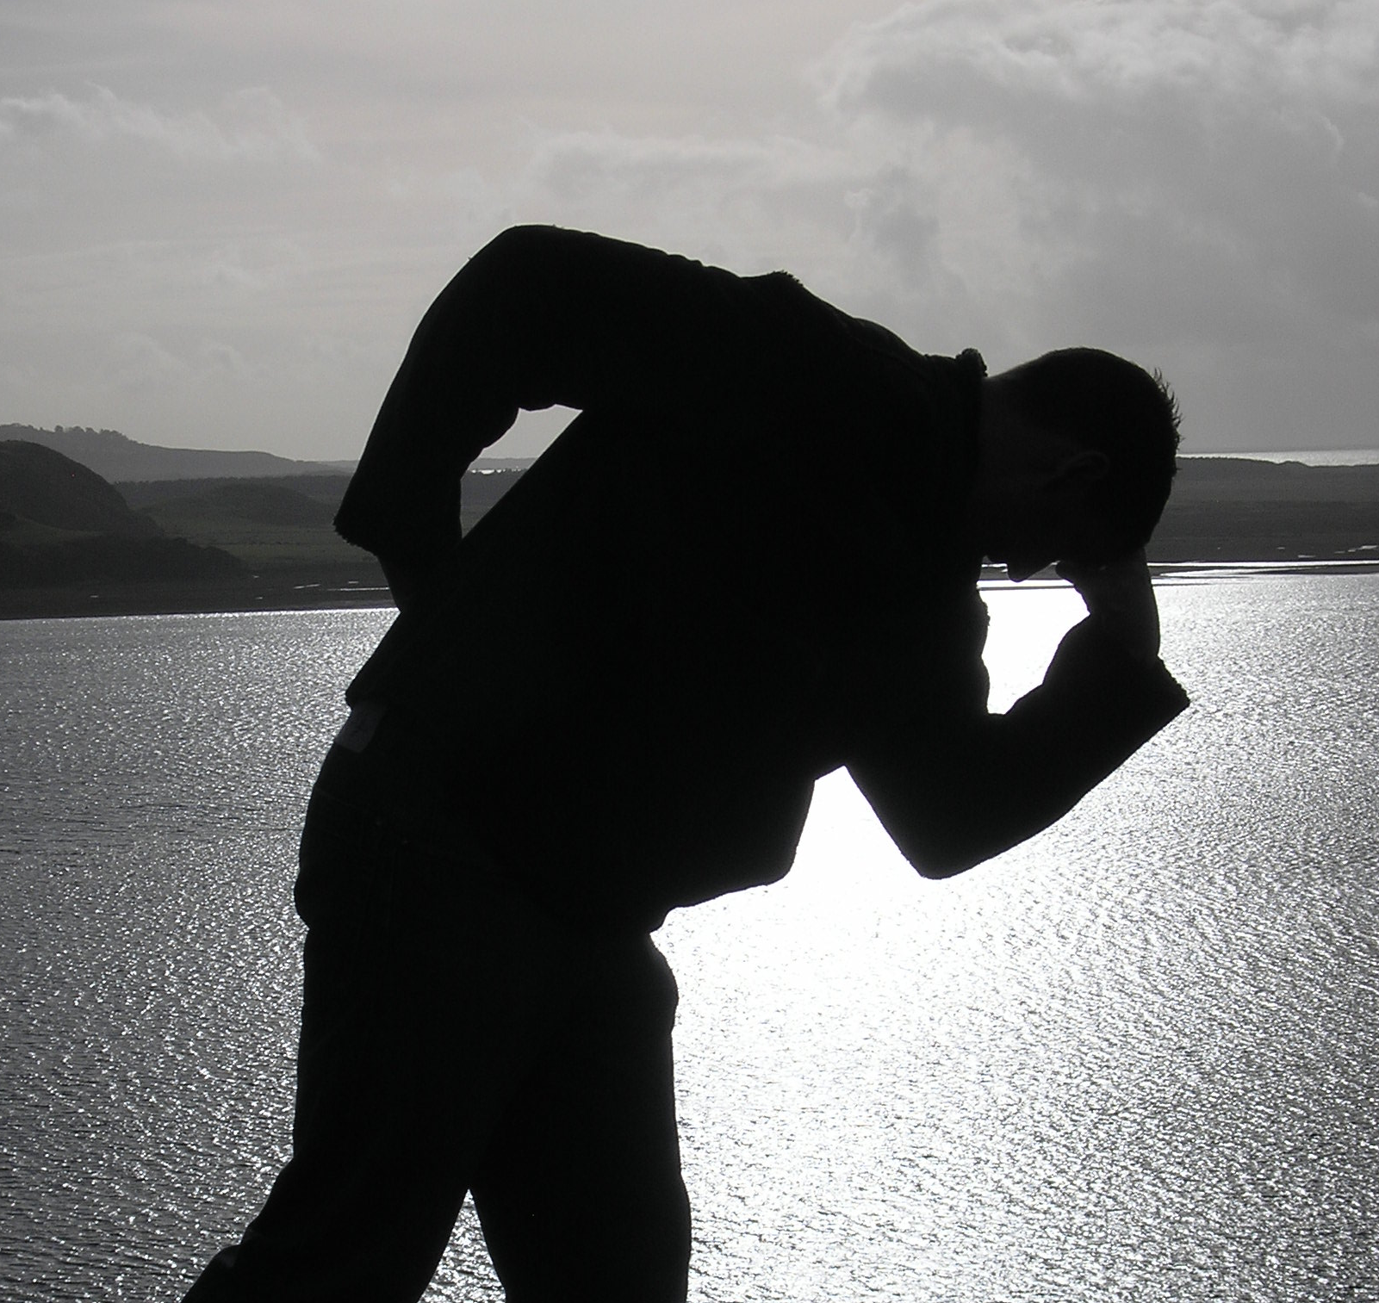
The result of getting it wrong…
Nothing much can be done to help
If I exercise my joints will wear out even quicker
It’s not safe for someone like me to exercise
Rest is best

Slide 31
Giving an explanation
There is no clear tested ‘best’ explanation
Zero tolerance for jargon!
Back it up with written information
Patients want a clear and meaningful diagnosis
Paskins et al 2015

Slide 32
Quality written information

Slide 33
Essential component:
Osteoarthritis
?
Why?
Caution!
Matches:
NICE OA Guideline Patient information
Still needs an explanation….

Slide 34
In pairs or trios…..
Find your own words to explain osteoarthritis confidently to patients
Give the explanation of knee OA to your colleague as if he/she were a patient
Remember:
Plain English
No Jargon

Slide 35
How did you get on?
What language did you use?
It’s a bit of “wear and tear”…
What message did you convey?
Notes:
Ask participants what language they used – write down key words or phrases
Highlight that 8 in 10 GPs use ‘wear and tear’
Ask participants what messages the phrases they have used will convey? – Did they think about it at the time?

Slide 36

What you say and what patients hear…
Notes:
Research experience and evidence demonstrates that what you say and what patients hear and interpret from this are not always the same thing

Slide 37
What patients hear…
What you say …
I don’t want to worry them
You are getting old and have worn your bones out
It’s familiar and understandable
It’s only going to get worse
“Wear and tear”
There is nothing that can be done
Exercise will wear my joints more
Its normal
Drew Moore, Keele Univ. personal communication from MOSAICS study
Paskins et al. Ann Fam Med. 2015; 13(6): 537-44.
Barker et al. Disabil Rhabil. 2013; DOI: 10.3109/09638288.2013.793409
Notes:
So let’s start with the most commonly used phrase “wear and tear”
We think it is used by HCPs because it is unintimidating, reassuring and avoids jargon – Barker et al stated that patients find the phrase approachable and easy to understand, – particularly compared to what is seen as the alternative, and alarming, phrase ‘‘degenerative changes’’
Some people prefer to have a diagnosis as they feel this validates their symptoms – however others feel reassured by a non-medical term
In my work, the term osteoarthritis was recognised as “disastrous” by one GP
However, we know that wear and tear is this is interpreted in a whole host of different ways by patients
Barker found that:
women consistently and strongly tended to respond negatively to the implication that ‘‘wear and tear’’ was a sign of getting old
he term also had unhelpful connotations some several of the participants that arthritis is untreatable or that the GP is not taking their condition seriously
Discussing wear and tear could lead to talking about feelings of guilt or resentment at having pursued enjoyable and healthy activities that were implied to have caused the wear and tear.

Slide 38
Further problems with “wear and tear”
Inaccurate
Neglects likely inflammatory and reparative processes
Too simplistic for this metabolically active condition
Suggests that given adequate longevity we would all get it

Slide 39
What patients hear…
What you say …
“Arthritis”
I have heard of this
I am not quite sure what this means
That means I have damage to cartilage
Barker et al. Disabil Rhabil. 2013; DOI: 10.3109/09638288.2013.793409
Notes:
Arthritis is considered accessible and is commonly used
Patients are familiar term with this
However – they may not be quite sure what it means – some think it may mean both osteoarthritis and rheumatoid arthritis.
Patients sometimes interpret this as ‘‘damage to cartilage’’ and associate it with pain.

Slide 40
What patients hear…
What you say …
“Osteoarthritis”
What does that mean?
Osteoporosis
Thinning of the joints
Less serious than rheumatoid arthritis
Worse than arthritis
Wear and tear
Barker et al. Disabil Rhabil. 2013; DOI: 10.3109/09638288.2013.793409
Notes:
Osteoarthritis is far less familiar term than arthritis
It is often confused with osteoporosis and, linked to this, may be interpreted as thinning of the joints
Some consider it less serious than rheumatoid arthritis.
Others think it may be more serious and more worrying, than arthritis
Some people are very clear that they have osteoarthritis which is the ‘‘wear and tear’’ version of arthritis.

Slide 41
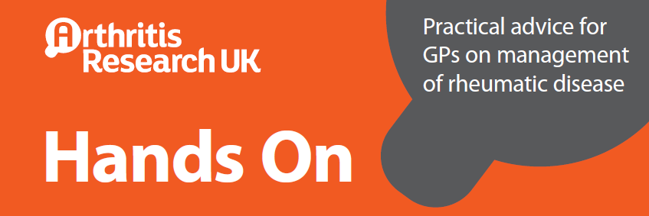
What patients hear…
What you say …
I will reassure the patient
Good news
“It is not rheumatoid arthritis”
What does that mean?
?Not reassurance – e.g. no disease modifying treatment
Paskins et al. Ann Fam Med. 2015; 13(6): 537-44.
Barker et al. Disabil Rhabil. 2013; DOI: 10.3109/09638288.2013.793409
Notes:
GPs have been found to spend more time explaining what OA was not than what it was –
They are trying to reassure patients and
This is an approach advocated within Hands On advice published by Arthritis Research UK
While there is some evidence showing that some patients will interpret this as good news
Telling people it is not rheumatoid arthritis may cause further misunderstanding

Slide 42
What patients hear…
What you say …
Treatable
Inflammation
Spreading problem
Effusion
Bones are fusing
Degenerative change
My joints are crumbling
Barker et al. Disabil Rhabil. 2013; DOI: 10.3109/09638288.2013.793409
Notes:
Other terms that may have come up include:
Inflammation – this has been found to be is familiar to patients and can be interpreted positively as being treatable e.g. with anti-inflammatories
Effusion – is not familiar to patients can be interpreted as bones fusing together or the problem being likely to spread
Degenerative change is not familiar to patients and was often interpreted negatively – that joints are crumbling and the process is irreversible

Slide 43
What patients hear…
What you say …
“Wear and repair”
?????
Notes:
“Wear and repair”
However, we don’t really know what patients understand by this

Slide 44
“Wear and repair”
May be more accurate characterisation of the process
A bit clumsy?
Still emphasises bone and cartilage
Better concept of “repair” might be:
  restoration of muscle tone
  tightening ligaments
  improved posture
  …all of which improve function and pain
Notes:
However wear and repair is recommended in Arthritis Research UK guidelines as a way of communicating the diagnosis
It is argued it aligns with the concept of flares and episodes of being more settled
Some feel it is a bit clumsy and may still lack clarity
Although there is experimental evidence that cartilage can repair if load is removed – it maintains emphasis on bone and cartilage and current understanding of joints is that it is more than just bone and cartilage
It may therefore be better to think about, and communicate, repair more broadly – for example – strengthening weakened muscles and tightening ligaments and improving poor posture
These process will improve function and reduce pain which can be argued to be a type of repair

Slide 45
Essential component:
Osteoarthritis
Validates patients’ suffering
Reduces risk of normalising symptoms and providing unwanted reassurance
First step in the process of information giving
Paskins et al. Ann Fam Med. 2015; 13(6): 537-44.
Notes:
So to summarise:
We now come back an earlier concept – that giving people their diagnosis using its correct term is essential
It has been suggested that this :
validates patients’ suffering
reduces the risk of normalising patients' symptoms and providing unwanted reassurance
Starts the process of giving information
Once you have given this diagnosis, to improve patients’ understanding you will need to find words that you can use to help people to understand this further

Slide 46
Suggested structure for OA explanation
Ask what the patient knows about OA
  May highlight misconceptions in need of address
Validate the problem (so NOT simple reassurance)
The whole joint
  bone / cartilage / synovium / muscle / ligaments
Stresses to the joint – wear
  injury / sport / work / weight / malalignment
Capable of repair / not inevitably worse
Something we can do
  strengthen muscles / lose weight / reduce inflammation / help pain
Notes:
We propose that the following structure could be used
…
However we need to be careful about the language we convey this information with

Slide 47
Supporting OA self-Management
Andrew, Lizzie and Vince
Notes:
3 groups with facilitator and flip chart – discussion on how to support self-care focussing on
Weight loss
Pain management
Physical activity and exercise
Share with other groups and discuss principles
Prompts:
Understand where the patient is at
Guiding not advising
Agenda setting
Goal setting
Goal review
Written info
Motivational interviewing approach

Slide 48
Supporting OA self-management
The problem, and ideas / concerns / expectations understood
The diagnosis is made
Diagnosis clearly given and explained
Offered good written information
Supported to gain the knowledge, skills and confidence to care for their symptoms and limitations in the most effective way

Slide 49
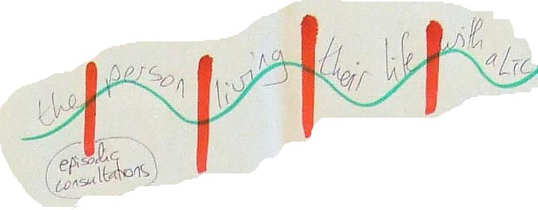
Supporting self-care
Most “care” happens outside of primary care consultations
Own experiences and lay networks are key
Patients manage without us most of the time
Notes:
This was a real strip of paper scribbled on by a patient with diabetes who said ‘this is me’ the red slashes are when I see people with my LTC but the periods in between are when I need support to help myself.
Making the point that we need to focus on supporting self-care

Slide 50
A model nurse oa consultation
Andrew, Lizzie and Vince
Notes:
1 or 2 groups with flip chart:
Produce a map or flow chart to use next week for a first consultation and a follow-up consultation

Slide 51


Managing OA in Consultations Study
Patient > 45 with joint pain
Enhanced GP consultation
Follow-up nurse consultation(s)
OA Template
Grime Health Expectations 2011, Dziedzic Implementation Science 2014, Edwards Rheumatology 2015
Notes:
To describe the approach
Starting point is the approach advocated in the NICE OA Guideline
Focussing on older patients presenting with joint pain
GP’s job is to:
Make give and explain the diagnosis
Address expectations (often pain)
Promote and support OA self-care – offer OA Guidebook and a follow-up appointment with a nurse
Nurse’s job is to support OA self-care
Link to next slide – why is supporting self-care important

Slide 52
Questions and homework
Notes:
Ask if any questions
Ask them to read the OA Guidebook
Hand out info on accessing the RCGP OA module

Slide 53
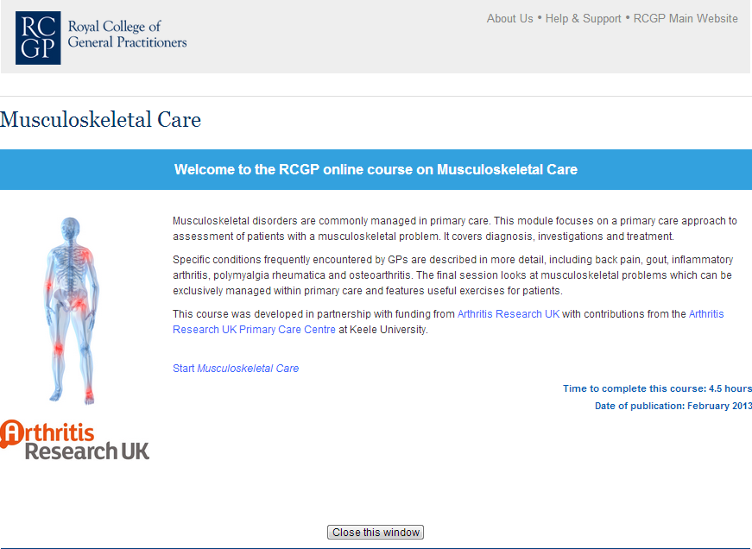
Notes:
To make participants aware of RCGP / ARUK OA module – there needs to be a hand out on accessing the module

Slide 54
Well done,
See you next week
Notes:
3 groups with facilitator and flip chart – discussion on how to support self-care focussing on
Weight loss
Pain management
Physical activity and exercise
Share with other groups and discuss principles
Prompts:
Understand where the patient is at
Guiding not advising
Agenda setting
Goal setting
Goal review
Written info
Motivational interviewing approach

